Slide 1
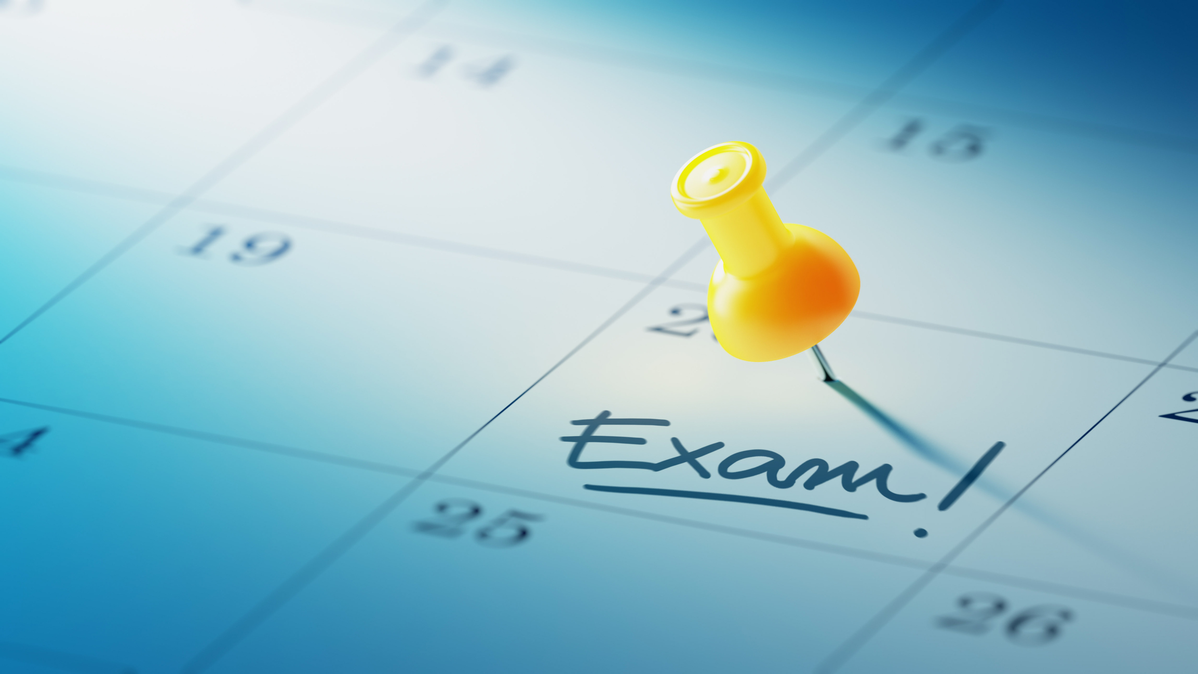
External Exams summer 2026
Prince Henry’s High School

Slide 2
Preparing to sit your exams
Make yourself familiar with the Candidate exam handbook
  IT WILL TELL YOU EVERYTHING YOU NEED TO KNOW
Check your personal exam timetable for the date, times and rooming for all exams
The Handbook and generic exam table are available on the Exams section of the main school website

Slide 3

Be on time
Nationally - The latest time an exam can start is
10am and 2:30pm
Arrive @ the exam room at least 15 minutes before your exam
If you are late this could result in your paper not being marked
If you are ill make every effort to attend your exam

Slide 4
Before you go in…
Empty all of your pockets – any paperwork found could result in a penalty from the exam board
Remove any charity bands from your wrist
Remove your watch and put it into your bag: a watch on your person in an exam room will result in a ZERO mark,
Ensure you do not have your mobile phone or other electronic device on your person: even if it is switched off, this will result in ZERO marks
Have all equipment for the exam ready in a clear pencil case, Maths tins and non clear pencil cases will not be allowed
Check you have your ID card
Line up ready out side the exam room
Use the toilet
Fill your CLEAR water bottle ready & remove any labels – any non clear bottle will not be allowed in the exam room

Slide 5
Ensure you follow the rules
NO TALKING FROM THE MOMENT YOU ENTER THE EXAM ROOM UNTIL YOU LEAVE
FACE THE FRONT AT ALL TIMES
DO NOT FILL IN THE FRONT OF THE EXAM PAPER BEFORE YOU ARE REQUESTED
DO NOT DOODLE ON THE EXAM PAPER
STOP WRITING AS SOON AS YOU ARE REQUESTED TO DO SO
NO PAPERWORK IN POCKETS INC EXAM TIMETABLE
NO WATCHES ON YOUR PERSON
NO PHONES ON YOUR PERSON

Slide 6
MAKE SURE YOU CHECK YOU EXAM PAPER HAS
THE CORRECT DATE & TIME
THE CORRECT SUBJECT
THE RELEVANT CODE
THE TITLE IS WHAT YOU WERE EXPECTING
THE TIER OF ENTRY (IF APPLICABLE)
This is MOST important in Science as there will be four different papers being taken at the same time the codes are very similar!

Slide 7
don’t PANIC!!
ANY PROBLEMS TELL AN INVIGILATOR ASAP –
      IF WE DON’T KNOW WE CANT HELP
IF AN EXAM DOESN’T START ON TIME YOU WILL BE ALLOCATED THE FULL EXAM DURATION
IF YOUR EQUIPMENT FAILS ASK FOR A REPLACEMENT
IF YOU HAVE FORGOTTEN EQUIPMWNT YOU NEED – ASK AN INVIGILATOR
IF YOU ARE UNSURE ABOUT ANYTHING CHECK
Once your exam has finished it could be too late to act

Slide 8
Equipment do’s & don’ts
Do bring...
ID card
A clear pencil case
A clear plastic water bottle
Relevant equipment
Don’t bring…
Calculator sleeves
Maths tins
Glass bottles
Resources & equipment not relevant to
the exam

Slide 9





Malpractice… Don’t think you wont be caught!
The Rules and Regulations we follow aren’t school rules
The school can’t protect any student from wrong doing
All misconduct needs to be reported to the exam board
https://www.youtube.com/watch?v=FBhRWbvjp9g

Slide 10
Be familiar with the exam posters

Slide 11
Fire alarm/bomb threat
Don’t panic
Inside or outside of the exam room- wait to be instructed by an invigilator
Do not go to your form fire assembly point
Exam students must assemble on the Astro turf for a fire evacuation but wait for an invigilator to take you
Do not continue working once an invigilator has requested you stop
Exam conditions apply throughout a fire alarm or bomb threat
Do not speak to anyone around you, the exam boards consider this malpractice

Slide 12
Exams Contingency
If there is local or national disruption to exams. the Exam Boards have allocated contingency dates within the timetable, where disrupted exams can be rescheduled.
Students must remain available for these dates even if they don’t have an exam
These dates are not for students who miss an exam due to illness or other personal circumstances

Slide 13




YOU’VE GOT THIS!!

