Slide 1
Exam Preparation

Slide 2
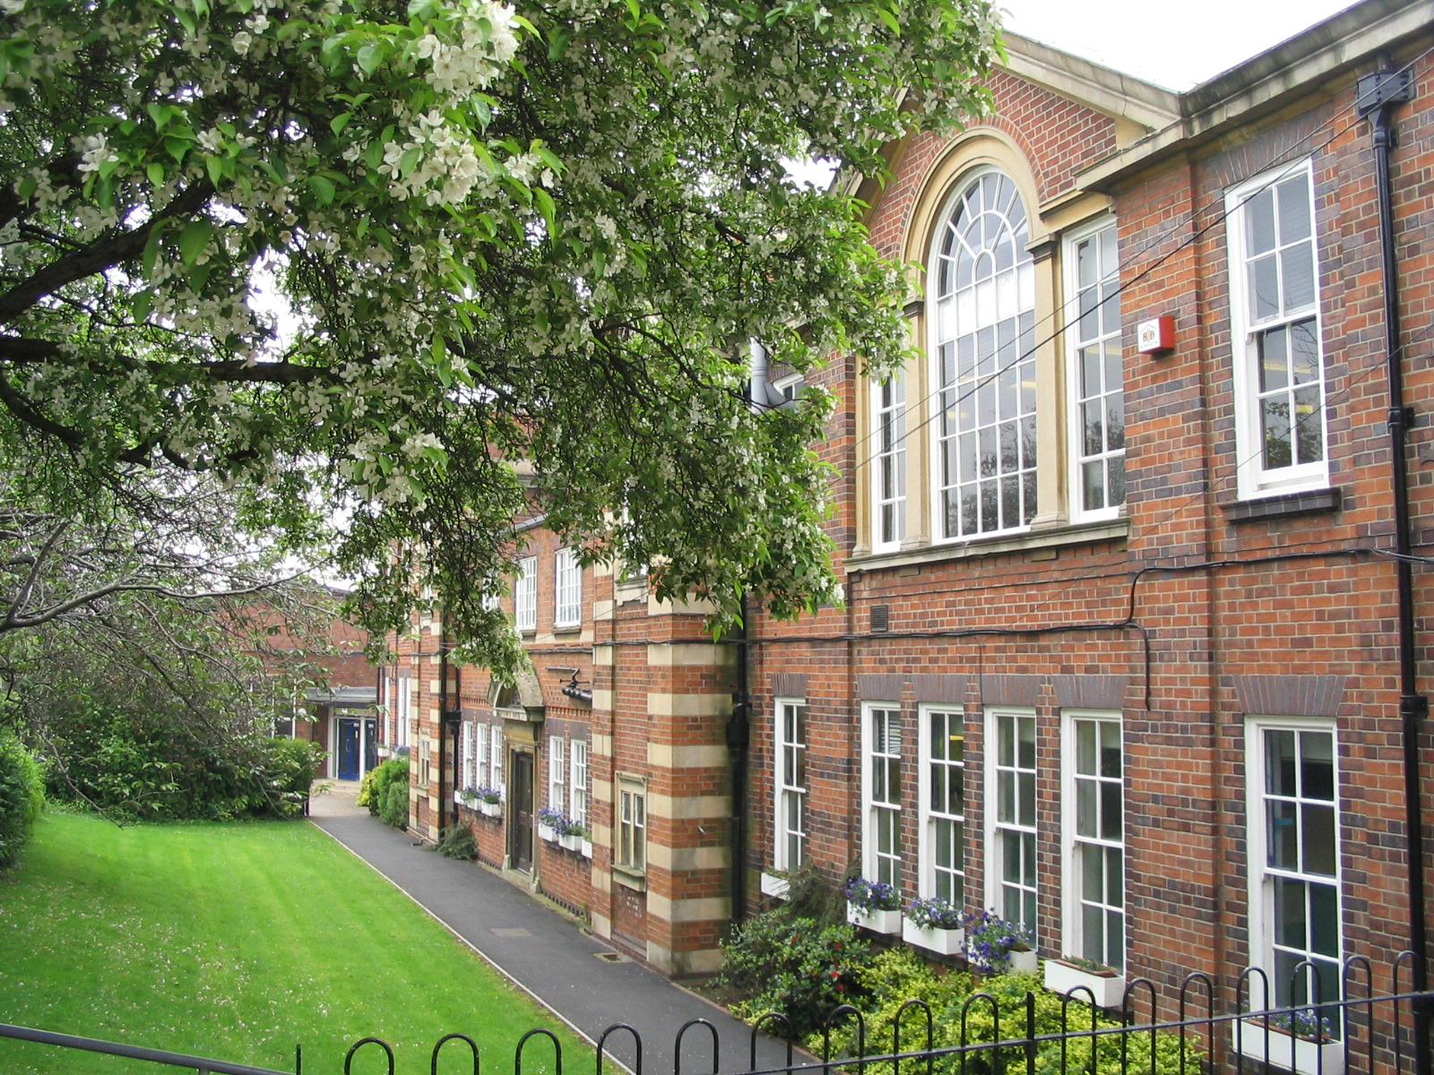

Exam Preparation
Purpose of the evening;
    How to revise
    How to make revision effective
    Preparing for revision and exams

Slide 3
Exam Preparation
First Exam in less than a month
Weeks left to prepare
Mock exams completed
Still time left to improve
You must start revising now (if you haven’t already started)
Lots of positives coming out of mocks
Should have a clear idea of areas to improve

Slide 5
What is revision?
Moving information into our long term memory store
Building pathways to retrieve information already in LTM
Cramming is not an effective revision technique
Knowledge should be built and developed over time
The more times information is visited the stronger the pathway will be
Resulting in quicker and clearer recall in exam situations

Slide 6
Revision Methods
You have heard from Maths, English and Science this week
Lots of ways to revise
Go with what works for you
Don’t just go for what is easiest
Revision is an active process (it is not passive)

Slide 7
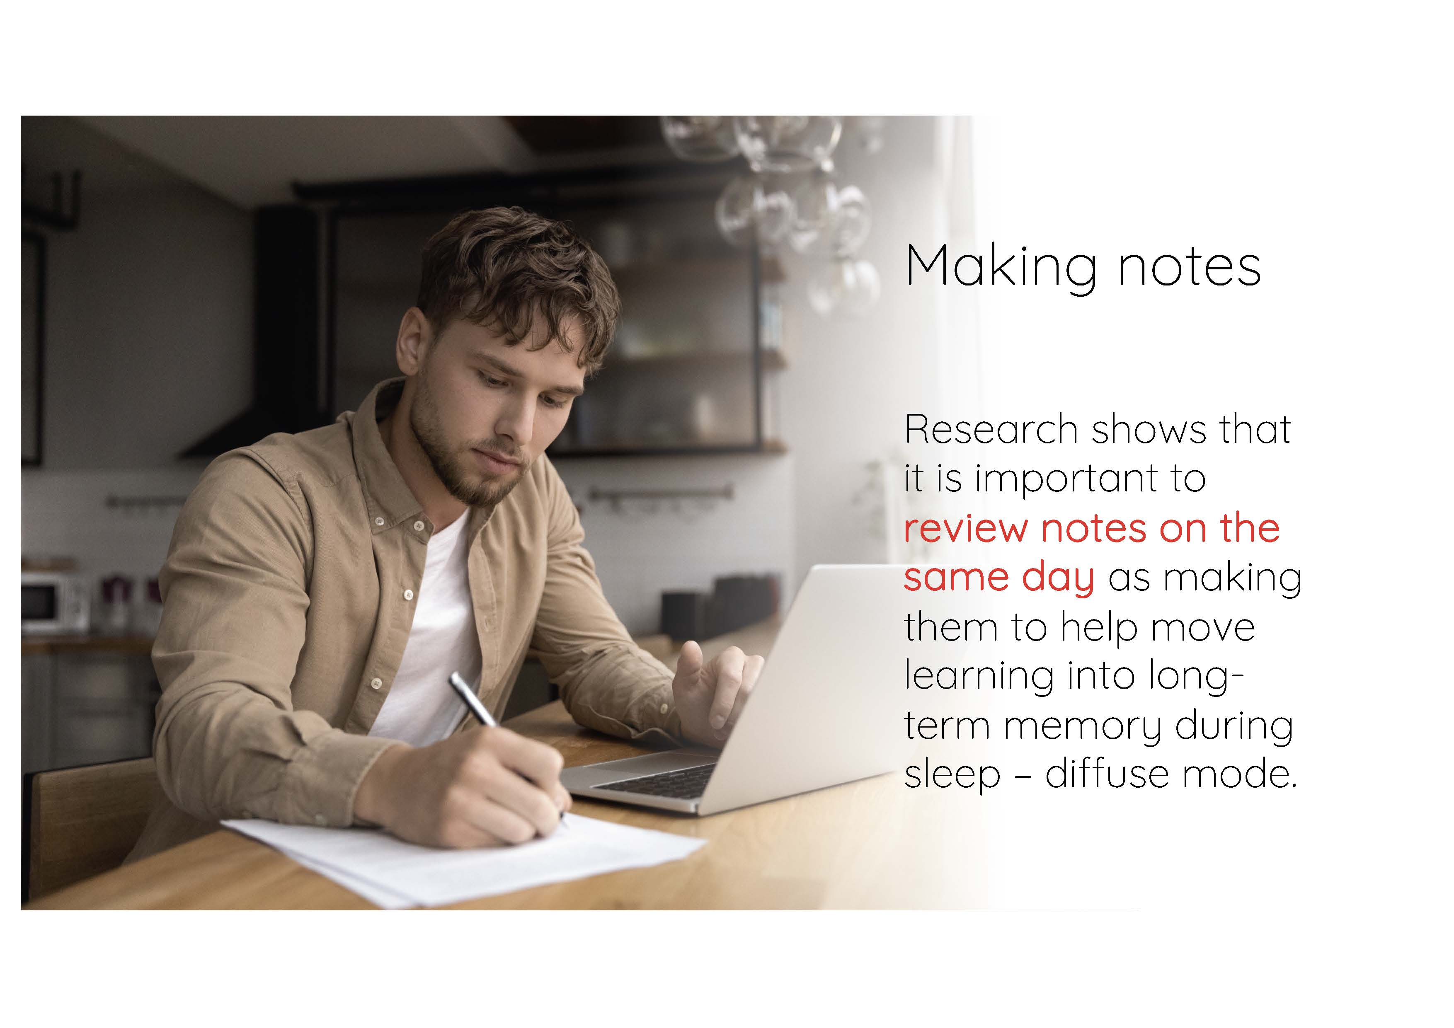
Making Notes

Slide 8
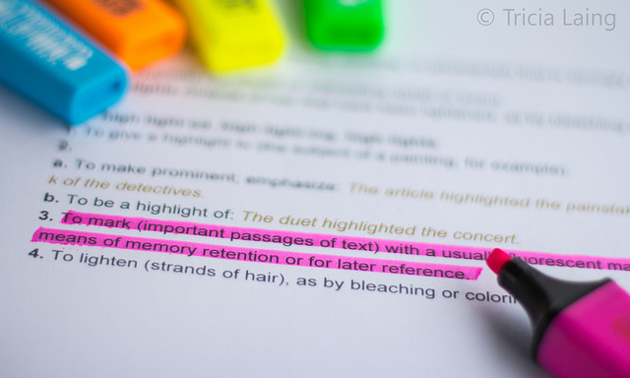
Highlighting

Slide 9
Making Revision Effective
Distraction free (no music, phones, screens or devices)
Start early to reduce stress and anxiety
Try different methods
Make use of revision resources (revision guides, exam board websites, past exam papers, PHHS Live, speak to your teachers)
Make sure you take breaks – during your revision and away from revision completely

Slide 10
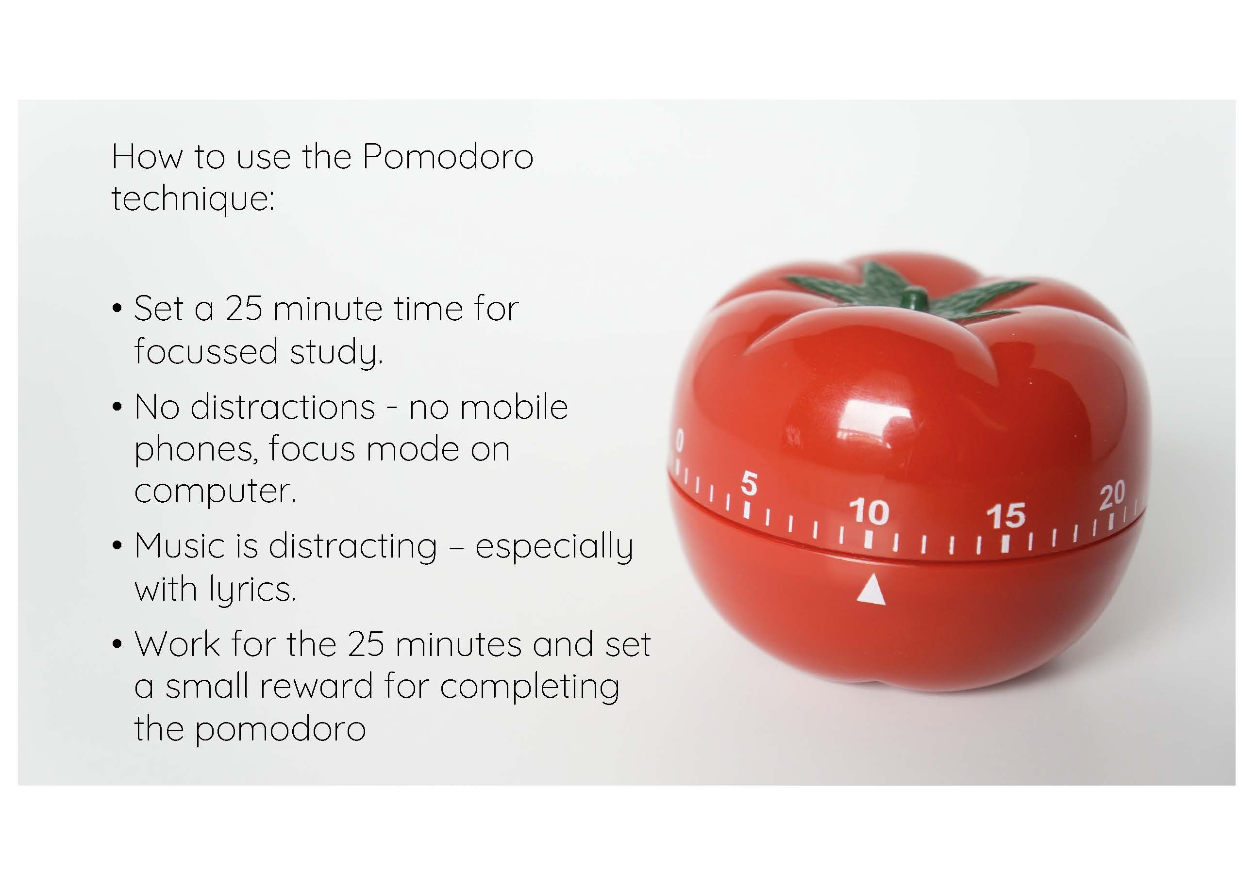
Pomadoro Method

Slide 11
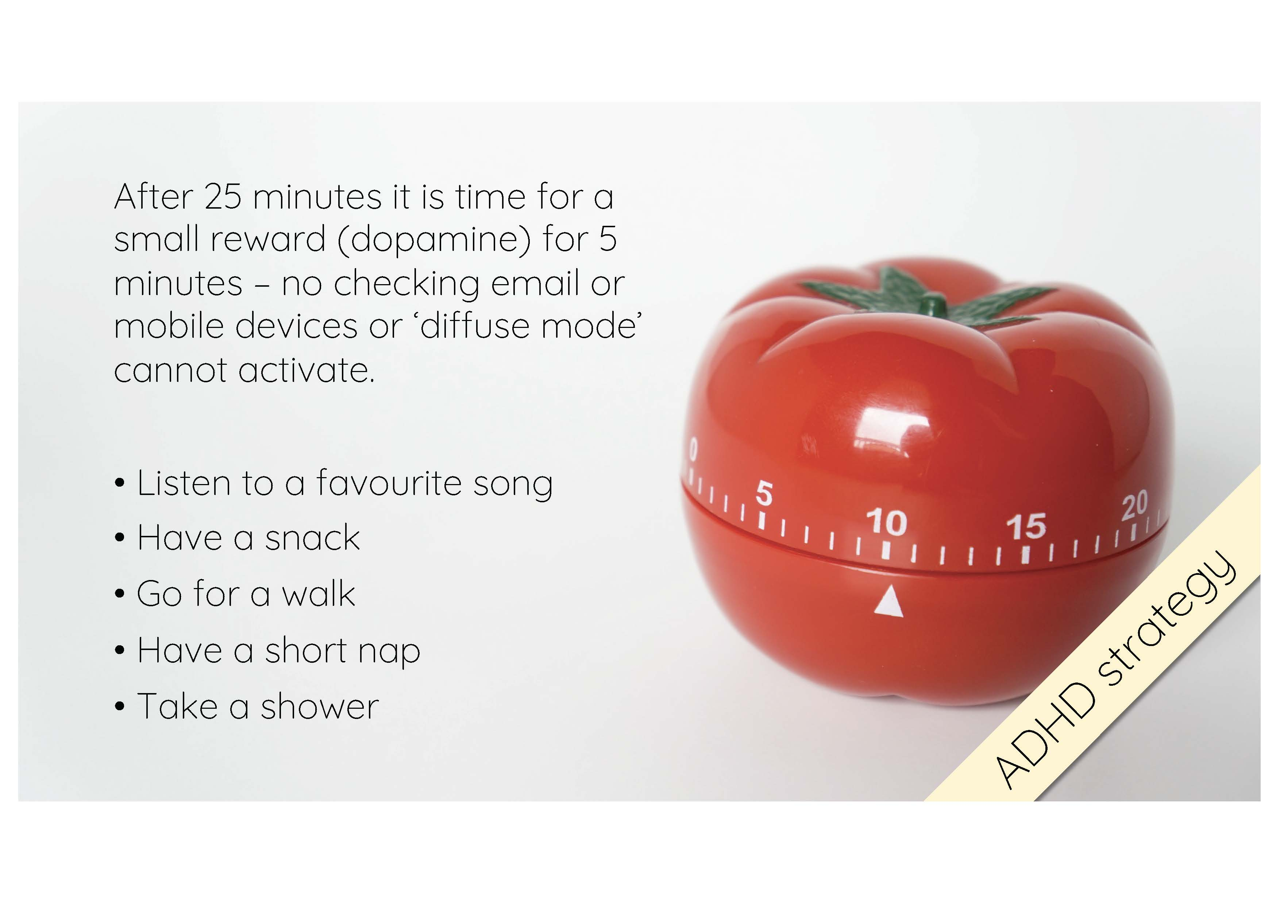

Slide 12
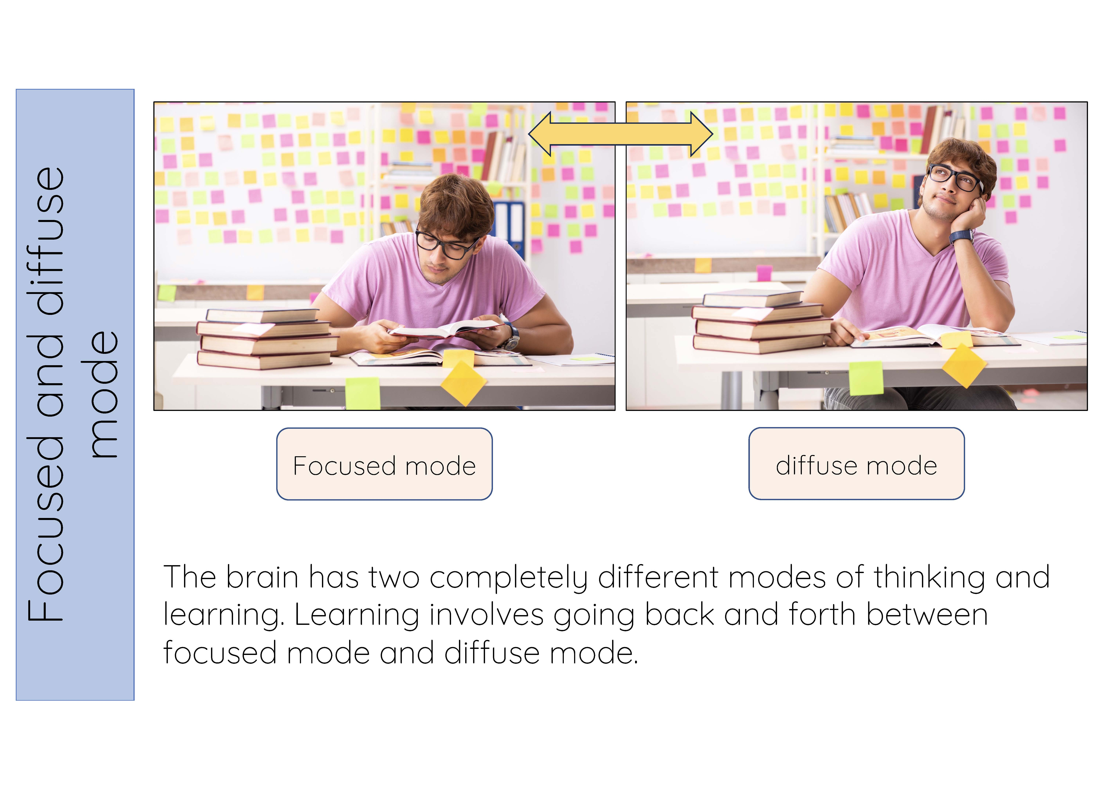

Slide 13
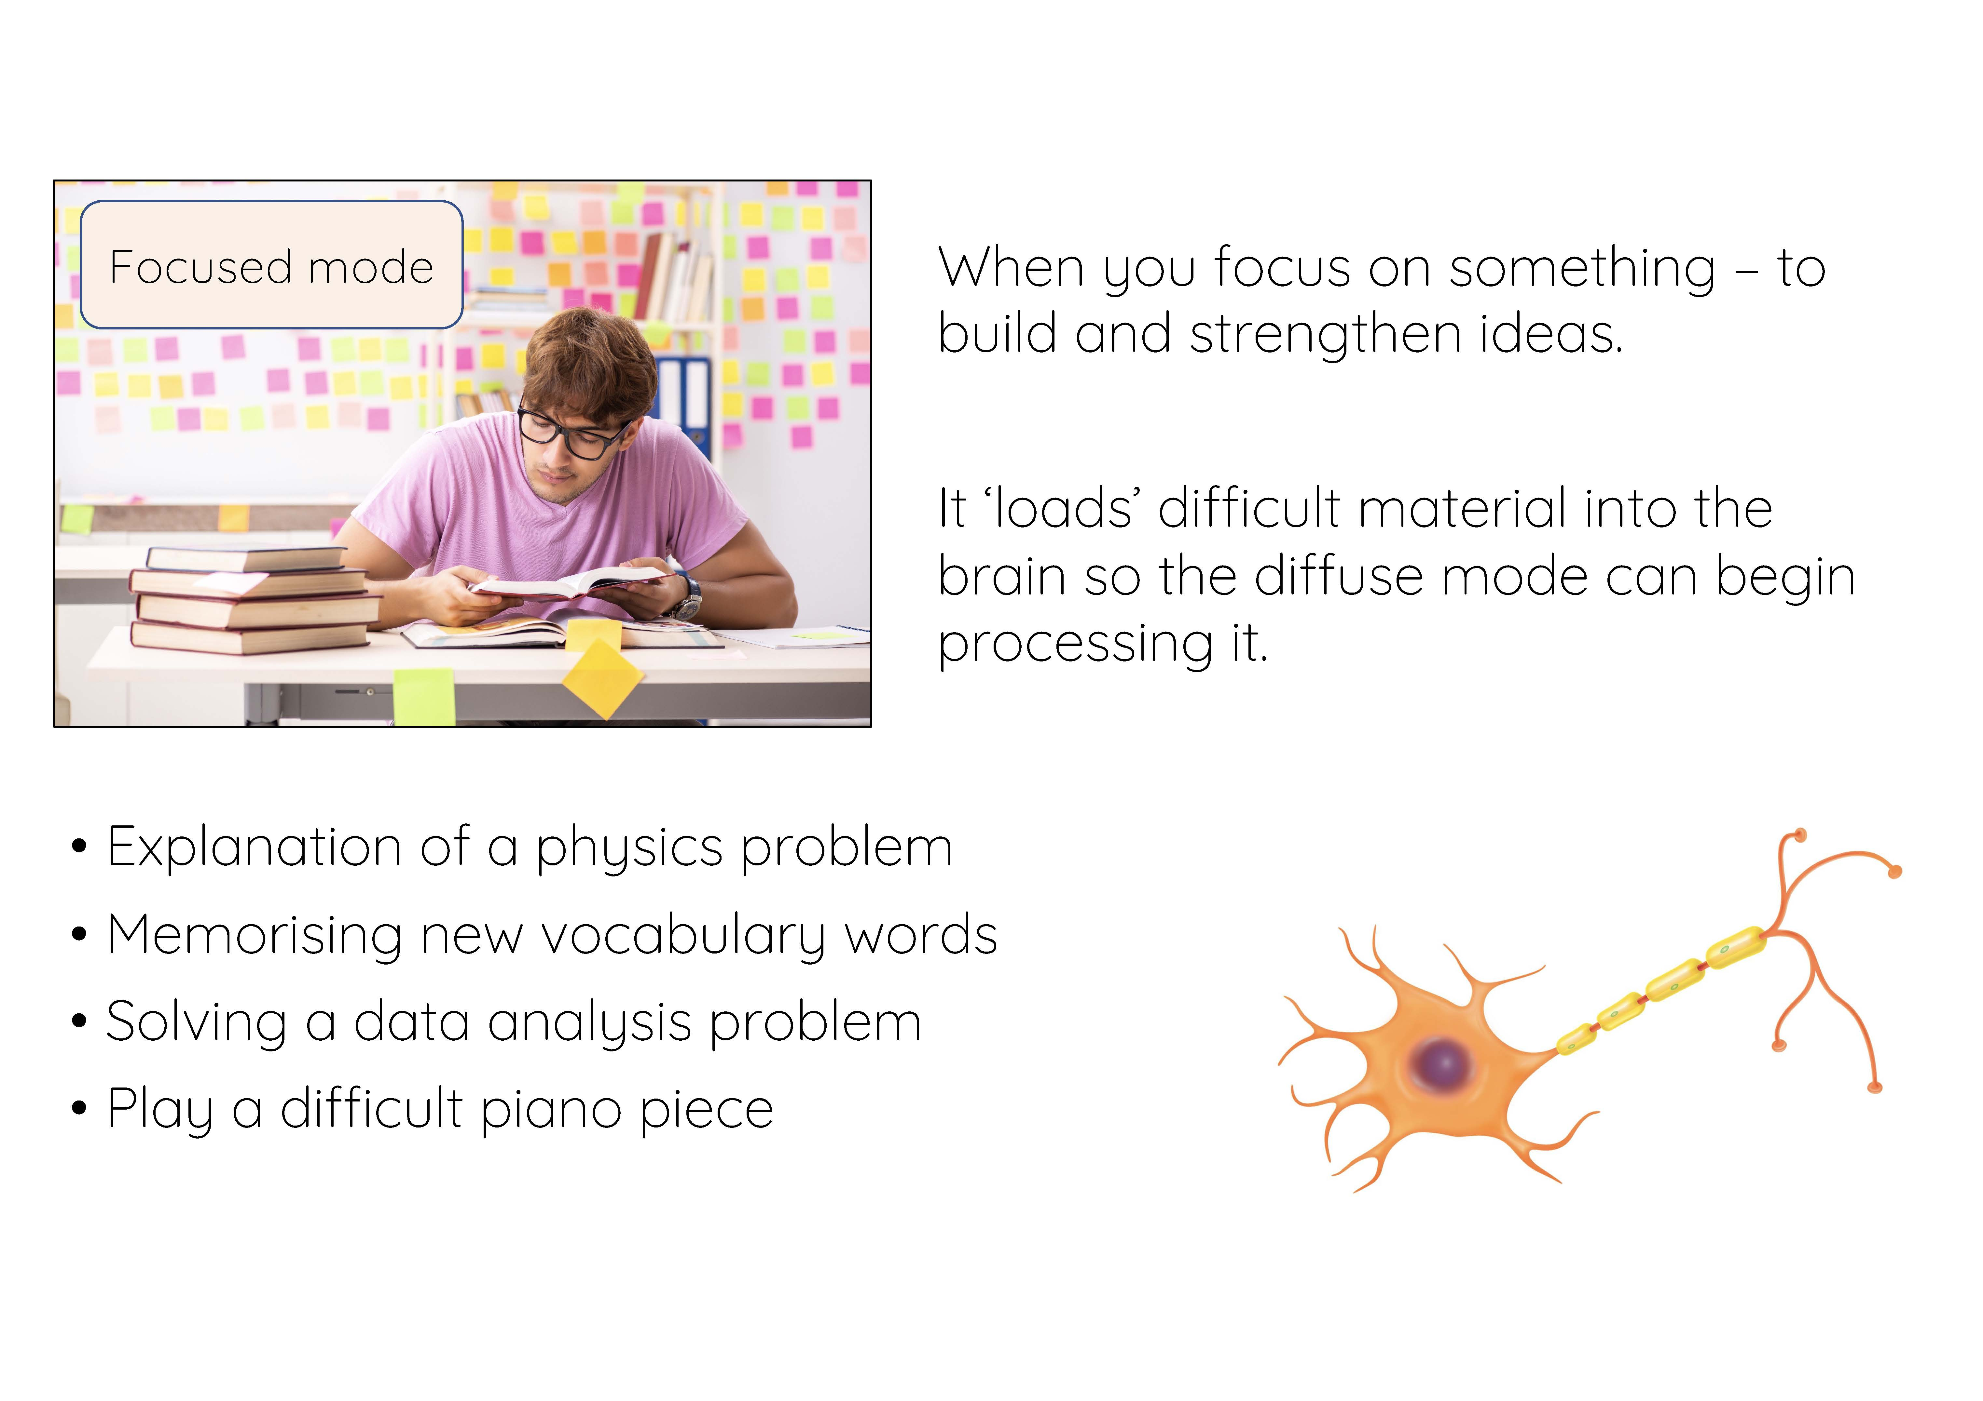

Slide 14
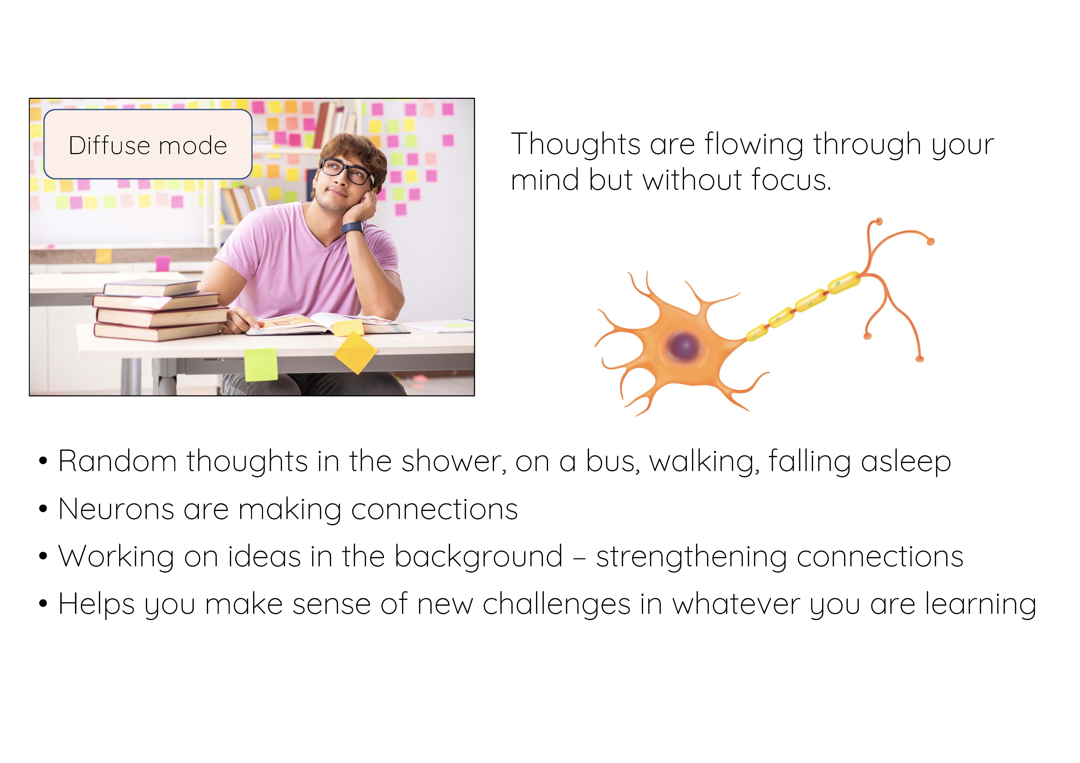

Slide 15
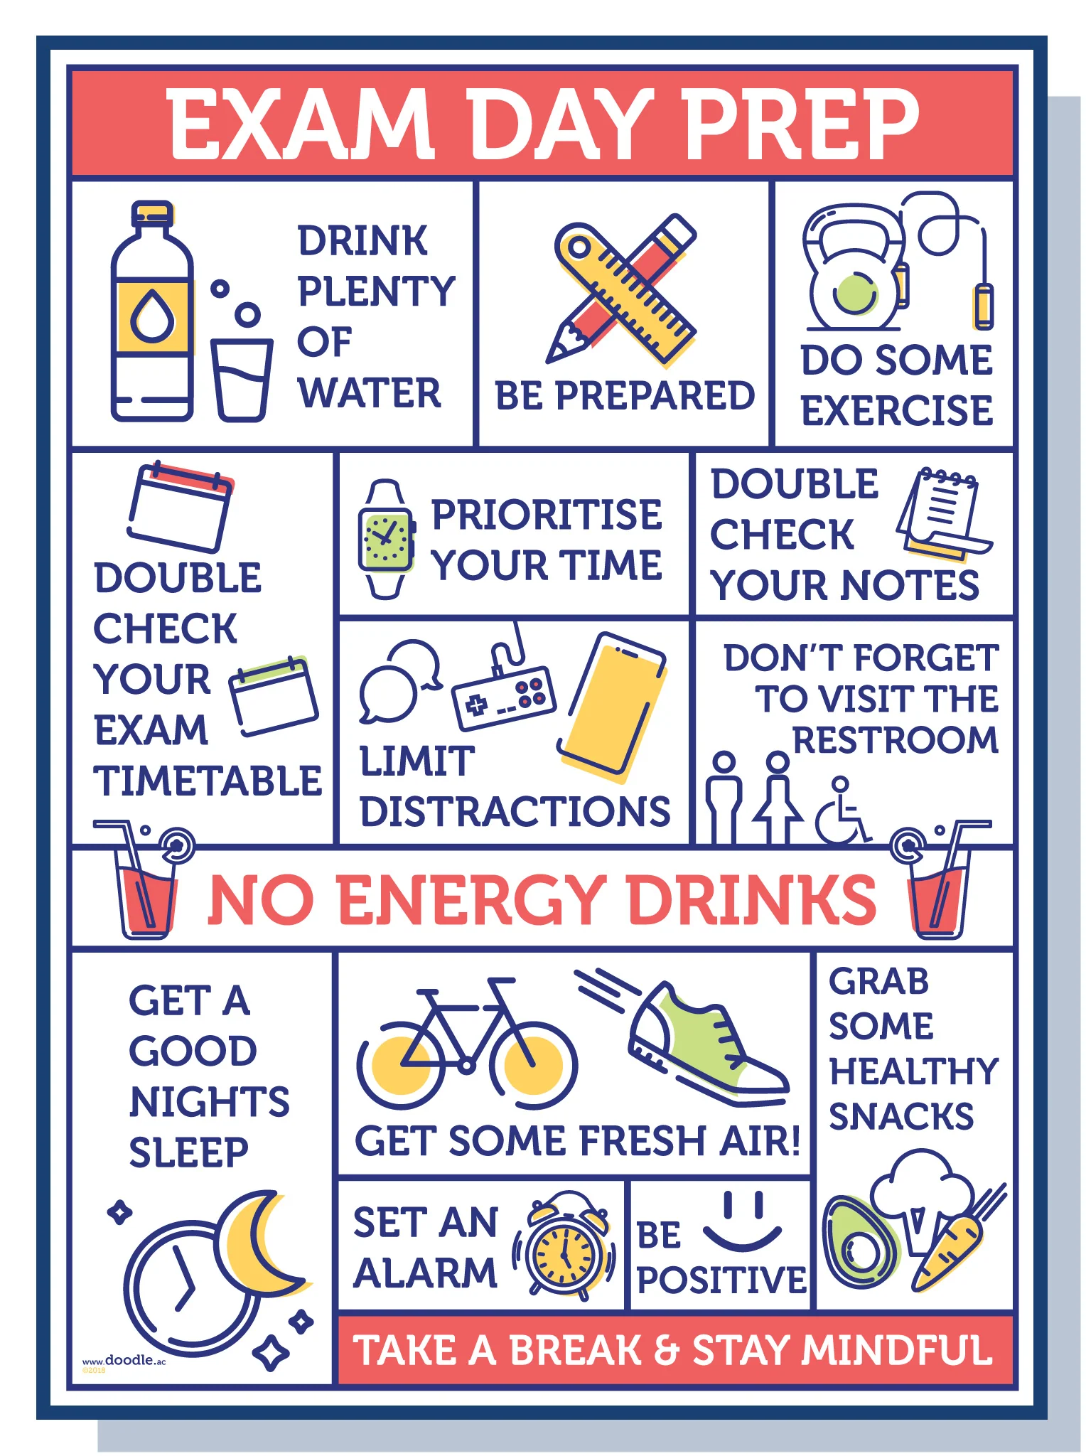
Preparing for Revision and Exams

Slide 16


Slide 17
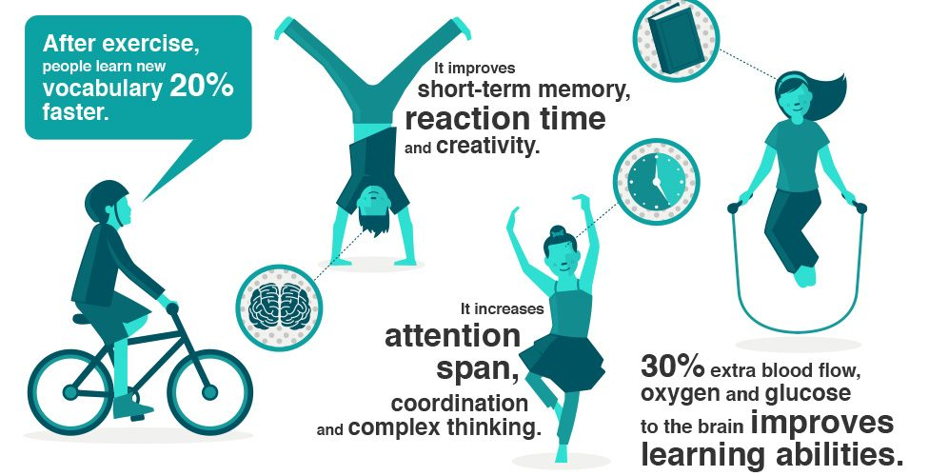

Slide 18
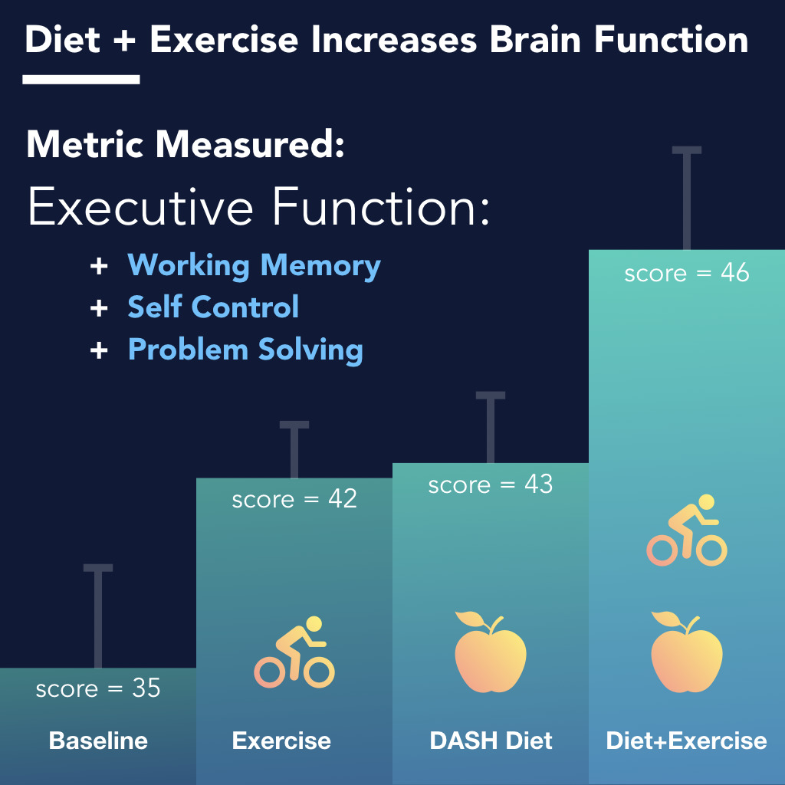

Slide 19
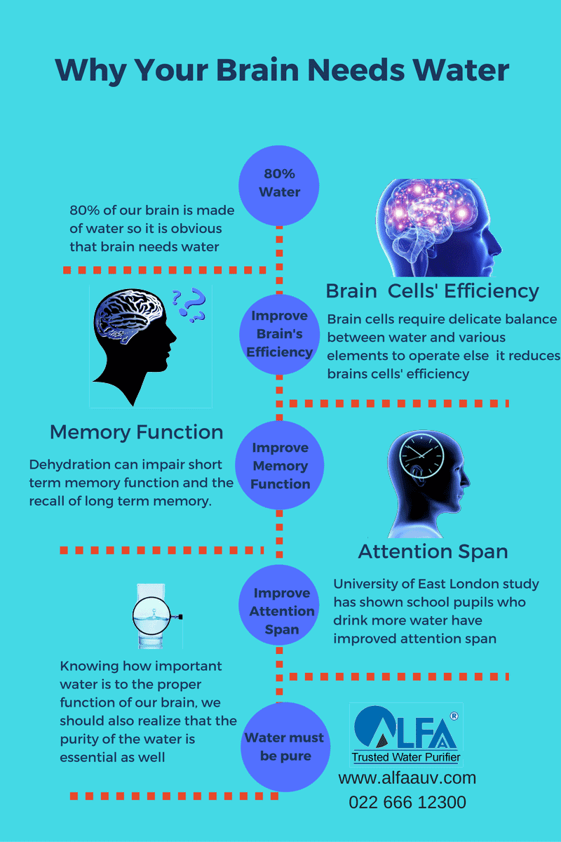
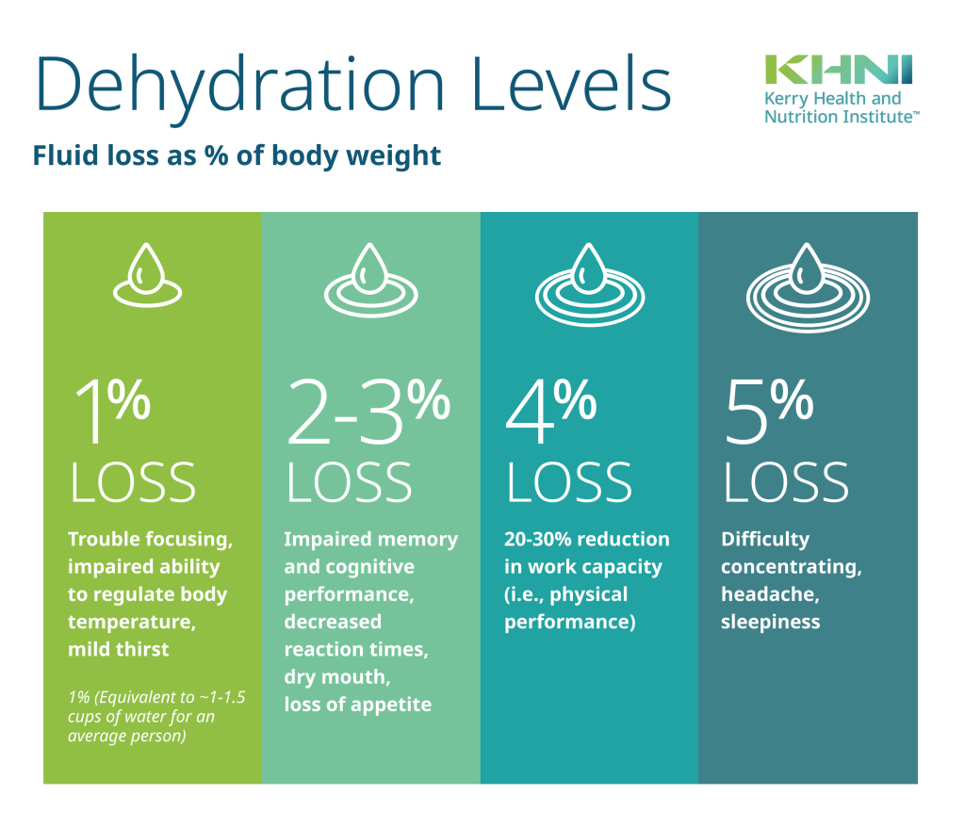

Slide 20


Slide 21
Title

