Slide 1
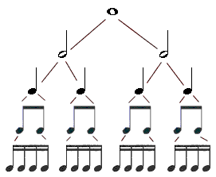
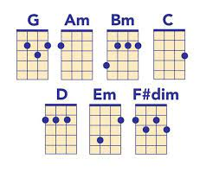
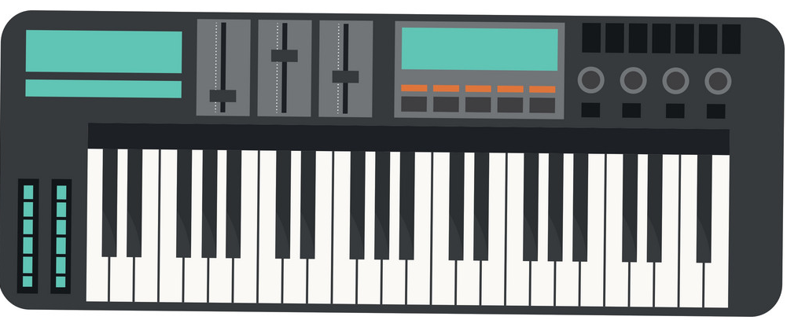
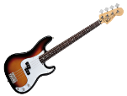
Music
A Levels T Levels Apprenticeships
Careers : Solo, Group Musician, Composer, Music Producer, Music Therapist, Private - Secondary School Music teacher, Sound Designer, Sound Engineer, Sound Technician, Broadcaster, DJ, Film and Video designer & Producer, Special Effects Technician, Arts Administrator, Broadcast Engineer, Radio Producer -Presenter, Talent Agent, Events Management, Choreographer
NEXT STEPS
Spring Term – 2nd half
Summer Term – 1st half
Summer Term – 2nd half
AOS Exam practice & exam 2
Submission solo performance
Exam practice and prep.
Develop Music theory skills and full theory exam
End of year Listening and Appraising exam
Spring Term – 1st half
Autumn Term – 2nd half
Autumn Term -1st half
YEAR
11
AOS Consolidation and exam prep.
First draft solo performance
First draft composition 2 – Exam brief
Wider listening AOS 3 &4 and Listening and Appraising exam
Develop Music theory skills
Submission comp.1 & group performance
Wider listening AOS 1 & 2 -Consolidation
First draft –composition 1
First draft group performance
Develop Music theory skills
Spring Term – 1st half
Summer Term – 1st half
Spring Term - 2nd half
Summer half -2nd half
music theory exam
Develop skills in group performance
Submission of songs and develop skills as a composer –film music
Study Fusion music, AOS 4 and end of year exam
Study vocal music AOS 3
Develop skills as a composer – Song writing.
first submission solo performance
Develop skills in Music theory
Autumn Term – 2nd half
Autumn Term – 1st half.
YEAR
10
Study Instrumental music from 17th and
18th C AOS 2
Develop skills in group performance.
Develop skills as a composer - Theme and Variation
Study Instrumental music from the 16thCentury AOS 1
Develop skills as a solo performer.
Develop creative skills melody and harmony
The piano –chords and melody
Film Music – Garage band
keyboard skills - Final solo performance
Develop keyboard skills
How to create mood and atmosphere in Music
Effective
Keyboard Performance Technique
YEAR
9
Performing Pop Music –Group work
Composing skills -Sibelius
The Instruments of the Orchestra –Brass instruments
Develop skills on Drum kit, guitar, voice working in groups
Develop skills on individual Brass instruments.
Develop listening skills and understanding of the Elements of Music
An introduction to computer software- Sibelius develop composing Music skills
The Bass Guitar
YEAR
6-8
Year 6-8 –Reading Music, pitch and rhythm, keyboard skills, programme music, structure and instrumental sounds, world music, jazz and ragtime, film music , them and variations
This Photo by Unknown Author is licensed under CC BY-SA

