Slide 1
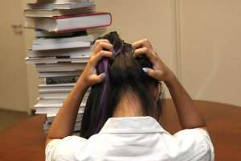
Ready to learn, ready to revise
What is anxiety? Why do we experience it?
Here is one idea:
“I get anxious, and become stressed, when I feel that other people’s expectations of what I can achieve exceed my own perceptions of what I am capable of achieving.”

Slide 2
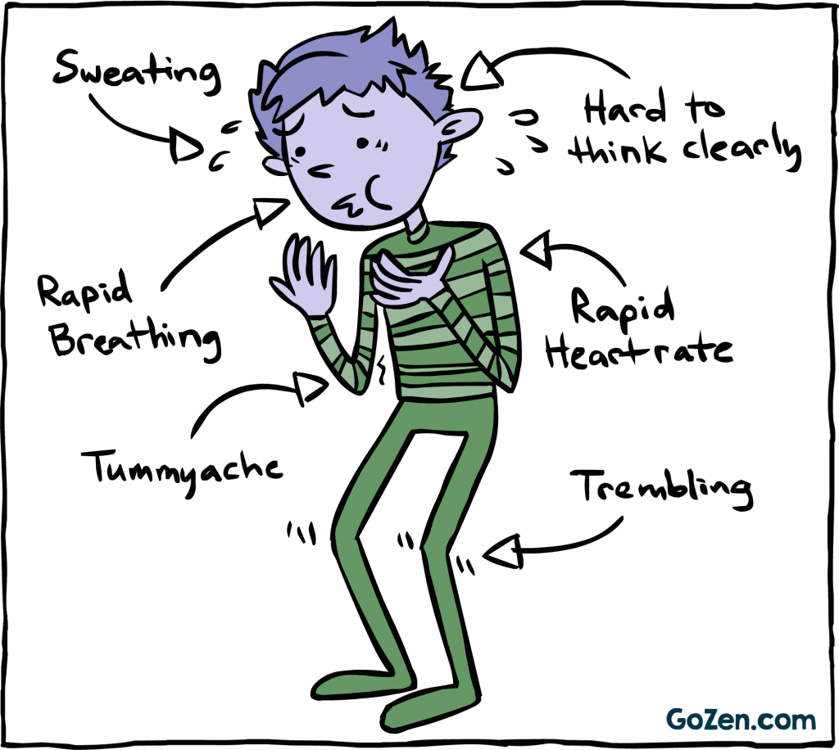
Anxiety and stress
It is normal to feel some anxiety about your GCSE exams. Anxiety can lead to the emotional and physical symptoms of stress. It can also help us focus on our work.
These symptoms might include:
feeling over-emotional
being withdrawn from friends and family
difficulty sleeping
loss of interest in hobbies and sport
sudden changes in mood
‘panic attacks’

Slide 3
Reducing anxiety, managing stress
A small amount of stress for a short period of time can enhance our performance, but being stressed or anxious for many weeks and months is not healthy.
Preparing yourself for exams should include taking steps to reduce your anxiety and manage your stress.
What things can we do to reduce our exam anxiety?
http://www.nhs.uk/Conditions/stress-anxiety-depression/Pages/Coping-with-exam-stress.aspx

Slide 4
Reducing anxiety, managing stress
The NHS recommends:
Planning out our your revision
Leaving enough time to revise properly
Using rewards and treats
Sleeping properly
Eating properly
Get physical exercise
Reducing distractions
The first three of these relate to your revision strategy. This is something we will look at in future assemblies and with your subject teachers.

Slide 5
Reducing anxiety, managing stress
The NHS recommends:
Sleeping properly
Eating properly
Get physical exercise
Reducing distractions
How much sleep do you get?
How much sleep should you get?

Slide 6
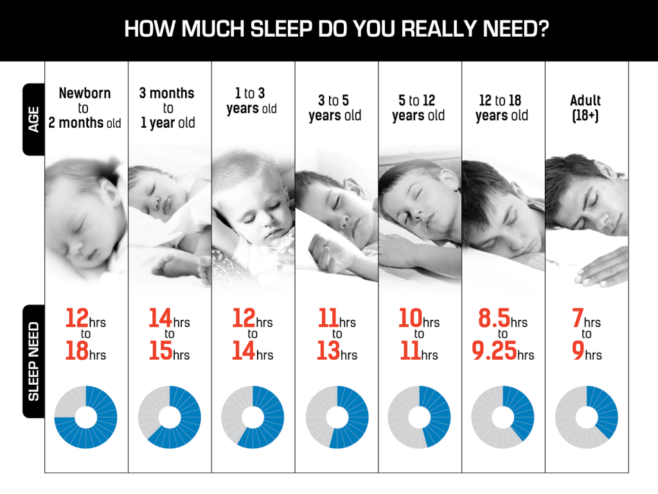
As a teenager, if you are not getting around 9 hours of sleep each night, you will be less effective.
You will learn less, remember less and be less proficient.

Slide 7
Reducing anxiety, managing stress
The NHS recommends:
Sleeping properly
Eating properly
Get physical exercise
Reducing distractions
Do you eat healthily?
What should you be eating to eat healthily?

Slide 8
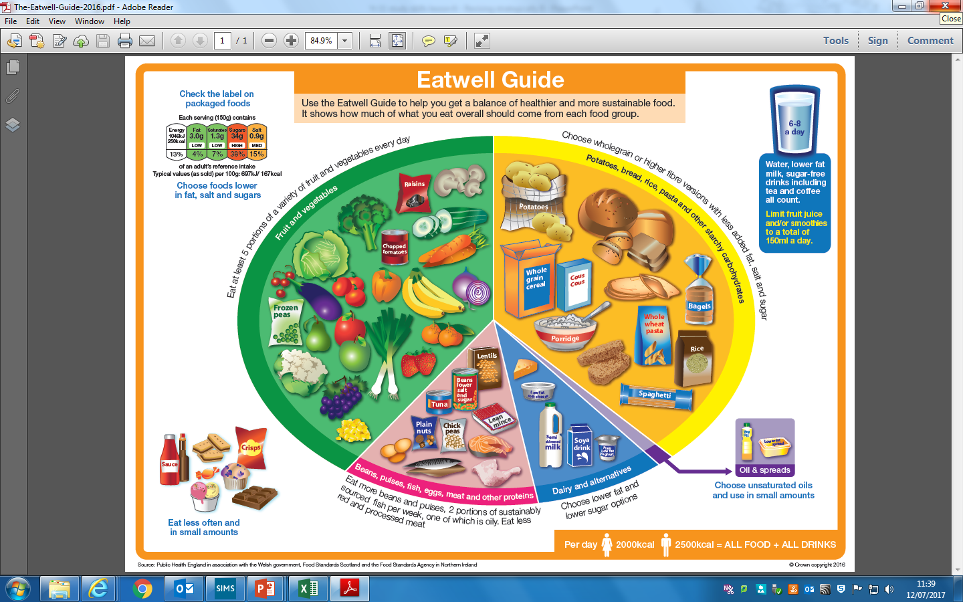
Top tips:
Eat a balanced diet (including plenty of fruit and veg)
Do not skip breakfast
Drink plenty of liquids
Consume enough calories (approx. 2000 kcal per day from all sources)
Notes:
There is an interactive Eatwell guide here: http://www.nhs.uk/Livewell/Goodfood/Pages/the-eatwell-guide.aspx

Slide 9
Reducing anxiety, managing stress
The NHS recommends:
Sleeping properly
Eating properly
Get physical exercise
Reducing distractions
Do you get regular exercise?
What is enough exercise?
Exercise is good for the body, but it is also good for the mind. Exercise reduces stress, makes you feel happier and helps you remember!

Slide 10
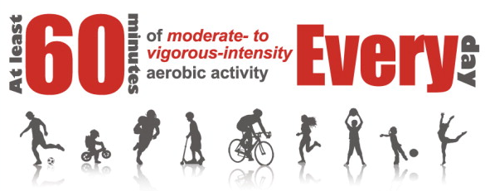
Moderate activity:
walking to school
playing in the playground
riding a scooter
skateboarding
rollerblading
walking the dog
cycling on level ground
Vigorous activity:
energetic dancing
swimming
running
gymnastics / trampolining
football / rugby / tennis
martial arts, such as karate
cycling fast or on hilly terrain
Notes:
Physical activity guidelines here: http://www.nhs.uk/Livewell/fitness/Pages/physical-activity-guidelines-for-young-people.aspx

Slide 11
Reducing anxiety, managing stress
The NHS recommends:
Sleeping properly
Eating properly
Get physical exercise
Reducing distractions
What stops you from studying or revising?
How can you remove these distractions?
Where you study and revise should be brightly lit and free of distractions. This means no TV and no social media usage!
If you like to listening to music while working, try a ‘focus’ Spotify play list, or other music with no words.

