Slide 1
Exam technique overview
Superpower relations and the Cold War 1941-91

Slide 2
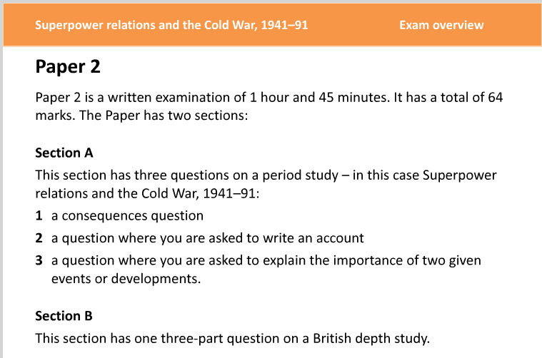

Slide 3
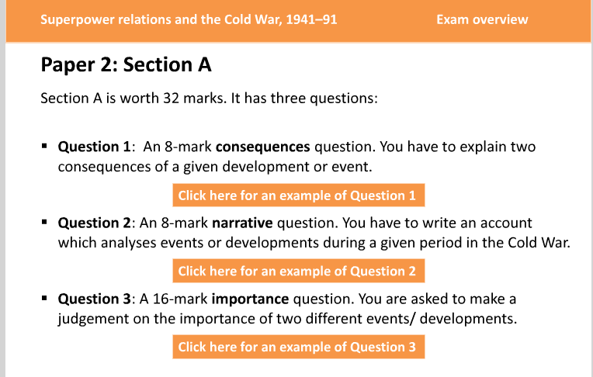

Slide 4
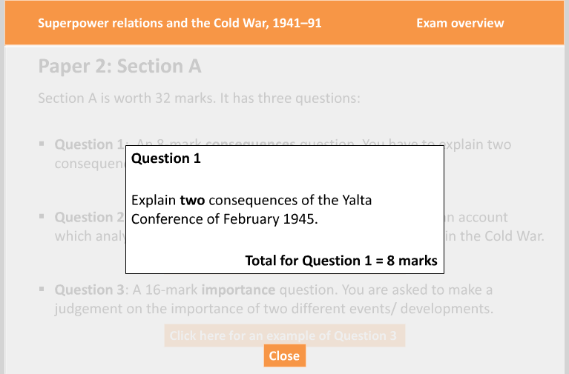

Slide 5
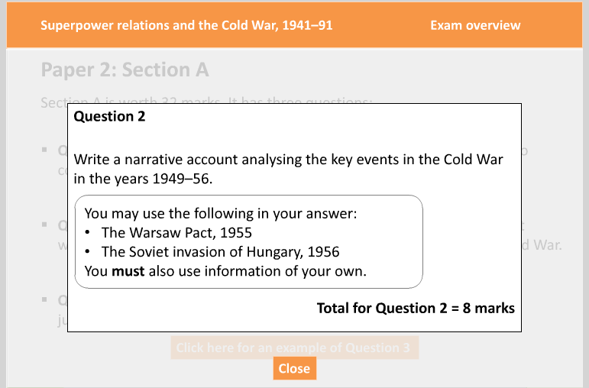

Slide 6
