Slide 1
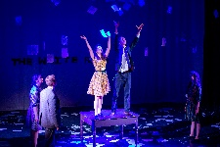
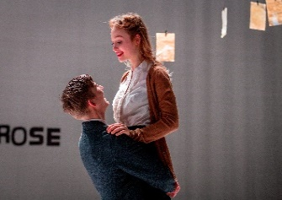
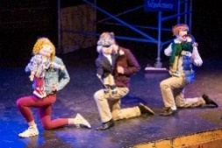
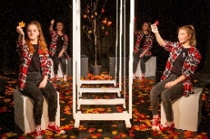

Drama and Theatre Studies
A Level
Component 1: Drama and Theatre
Degrees, Drama School
Careers: Arts Management, Broadcasting/Media, Law, Management Consultancy, Teaching or Television
The transferable skills are endless.
Component 2: Creating Original Drama
NEXT STEPS
Component 3:
Making Theatre
Component 1
Set texts and Live Theatre
Essays and feedback on-going
To consolidate knowledge and understanding of drama and theatre
To become confident writers under exam/timed conditions
Reflective Report marked by the AQA Examiner
Revision sessions after school
Spring 2
Component 3 Exam
March/April
Summer 1
Summer 2
Component 1 exam
June
Extract 3 performance to AQA examiner
Revision sessions after school
Written exam skills on Set texts and Live Theatre continued
To consolidate analysis and evaluation of the work of live theatre makers
Revision sessions available
Individual student evaluation consultations given throughout the course
All A- level Drama and Theatre Studies students have free online access to Digital Theatre, National Theatre online, recommended reading lists, glossaries, podcasts with many available resources/ materials in our Learning Resource Centre for wider reading
Methodology of prescribed practitioner (different one to Component 2 required)
Component 3
Extract 3 performance and Reflective Report analysing and evaluating theatrical interpretation
Choice of practitioner made for Component 2 and working groups
Live/digital theatre on-going
To continue to develop the process of creating devised drama
Live/digital theatre on-going
Autumn 1
Autumn 2
Component 2 Exam
December
Spring 1
YEAR
13
Practical exploration and interpretation of all 3 Extracts, with focus on performance of Extract 3
Component 2:Creating
Original Drama
Practical and Working Notebook
Component 1
Weekly essays and feedback throughout the term to continue to develop knowledge and understanding of drama and theatre
Component 2
Practical/Working Notebook.
Marked by teachers and moderated by AQA
Performance of devised drama influenced by the work and methodologies of chosen practitioner
Component 1
Weekly essays and feedback throughout the term
Drama school auditions and guidance given for University applications
As part of the Year 12 Elective, Gold Arts Award is also on offer as well as many extra-curricular activities
To continue to develop knowledge and understanding of drama and theatre with in-depth study of set texts and analysis and evaluation of the work of live theatre makers
Component 2: Creating Original Drama
Practical and Working Notebook introduced
Devised process for assessment in Year 13. Focus on Component 2 and requirements/AOs/marking criteria ready for September
Reflective Report considerations to process analysing and evaluating theatrical interpretation of
Extract 1 and 2
Continued study of Component 2 practitioners
Component 1:Drama and Theatre
Set texts continued and live theatre
Spring 2
Summer 1
Summer 2
Practical exploration and interpretation of three extracts taken from different plays. Extract 1 and 2 explored in Year 12
Continued practical work on Extract 1 and 2 for C3 practically explored and workshopped
To develop knowledge and understanding of drama and theatre, in-depth study of set texts and evaluation of the work of live theatre makers
Analysis and evaluation of the work of live theatre makers
To develop knowledge of drama and theatre, in-depth study of set texts
School productions and extra-curricular opportunities available
Live/digital theatre on-going
To understand the process of creating devised drama
YEAR
12
Spring 1
Autumn 2
Autumn 1
Introduction of Katie Mitchell and Extracts 1 and 2 for Component 3 practically explored and workshopped
Introduction to Component 3 : Making Theatre
Introduction of Component 2 practitioners
Frantic Assembly
Kneehigh
The Paper Birds
Mike Leigh
Steven Berkoff
Set texts practically explored as endorsed by AQA as performer/director/
designer
Social/historical/
cultural context introduced for each set text
Introduction to the course, practical and theoretical exploration of set texts for Component 1:Drama and Theatre
YEARS
10/11
The transition from GCSE drama to A Level works well as you continue to develop your skills and build your confidence using the skillset and transferable skills already acquired. Each Component follows the same format so you are familiar with the written and practical elements.
Links to GCSE: Drama, English Literature, Film Studies
Theatre trips and Digital streaming available throughout the course
This Photo by Unknown Author is licensed under CC BY-SA

