Slide 1
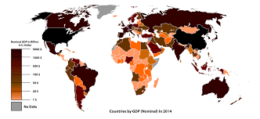
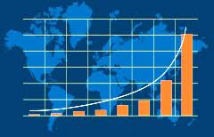

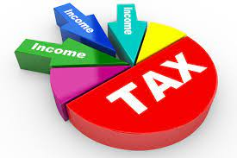
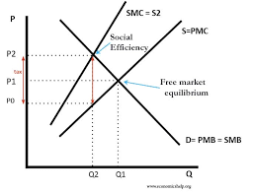
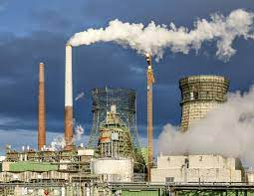
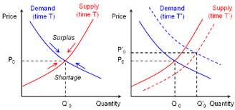
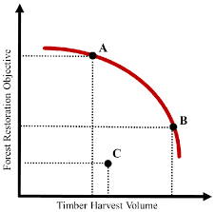
Economics A Level
An Economics A level will benefit all students, whether you plan to study at University, apply for an apprenticeship or enter the world of work. It is applicable to almost all choices of career, especially finance, management and strategy.
NEXT STEPS
Measures of development
Factors influencing development
Role of Financial Sector
Market failure in Finance sector
Public expenditure
Taxation
Development Economics
The Financial Sector
Role of the State
Strategies for growth
Role of NGOs
Central Banking
Monetary policy
Public sector finances
Macro policies in a global context
Inequality
Absolute and relative poverty
Terms of trade
Globalisation
Demand for labour
Labour supply
Poverty and Inequality
International Economics
Labour Market
GINI coefficient
Lorenz curve
International competitiveness
Exchange rates
Wage determination
Government intervention
Size and types of firm
Business growth
Business objective
Revenue and costs
Monopolistic Competition
Oligopoly
Business Growth
Revenue, Costs and Profit
Market Structures
YEAR
13
Perfect Competition
Demergers
Constraints of growth
Economies of scale
Profit in economics
Monopoly
Trade cycle
Causes of macro growth
Injections and withdrawals
Equilibrium levels of real national output
Influences on Aggregate Supply
Macro objectives & policies
National Income
Aggregate Supply
Demand and supply side policies
Output gaps
The multiplier
Circular flow
Long run AS
Short run AS
Max and minimum prices
Regulation
Economic growth
Inflation
Consumption
Investment
Government Intervention
Economic Performance
Aggregate Demand
Tax and subsidies
Government failure
Unemployment
Balance
of payments
Government Expenditure
Net Trade
Dead weight loss
Public goods
Elasticity
Demand
and supply
Economic systems
The economic problem
YEAR
12
Market Failure
How markets work
Nature of Economics
Externalities
Information failures
Rational economics and alternatives
Pricing mechanism
Production Possibility Frontiers
Positive and Normative
YEARS
10/11
GCSE Maths and English Grade 6 or above
This Photo by Unknown Author is licensed under CC BY-SA

