Slide 1




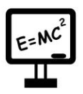

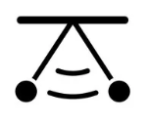




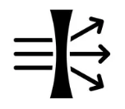





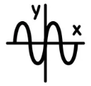
Physics A Level
Degrees: Physics, Maths, Engineering, Accountancy
Apprenticeships: Engineering, Finance
Careers : Astronomer, Civil Engineer, Medical Physics, Lecturer, Nanotechnologist, Radiation Protection Practitioner, Research Scientist, Teacher, Sound Engineer
NEXT STEPS
Decay
Radioactivity
Inverse square law
Binding
energy
Newton v Young
Millikan’s oil drop
Speed of light
Nuclear Physics
Turning Points in Physics
Magnetic Fields
Tesla
Flux Density
EM induction
UV catastrophe
Maxwell’s formula
Special relativity
Orbits
Potential energy
Satellites
Pendulum
Damping
Resonance
Springs
Gravitational Fields
Simple
Harmonic Motion
Electrical Fields
Thermal Physics
YEAR
13
Charge
Coulomb’s Law
Capacitance
Kinetic theory
Gas laws
Brownian Motion
Resultant forces
Vectors and scalars
Acceleration
Projectile motion
Young’s Modulus
Hooke’s Law
Mechanics and Materials
Waves and Optics
Standing waves
Nodes
Young’s Slits and Diffraction
Interference
Refractive Index
Optical fibers
Quarks
Particle Zoo
Photoelectric effect
Nuclei
Atoms
Quantum
A
YEAR
12
Particles and Radiation
Electricity
Measurements
and their Errors
Series
Electromotive force
Ohm’s Law
Accuracy
Uncertainty
Potential dividers
Graphs
Error Bars
YEARS
10/11
Energy, Electricity, Particle model of matter, Atomic structure, Forces, Waves, Magnetism and Electromagnetism
This Photo by Unknown Author is licensed under CC BY-SA

