Slide 1





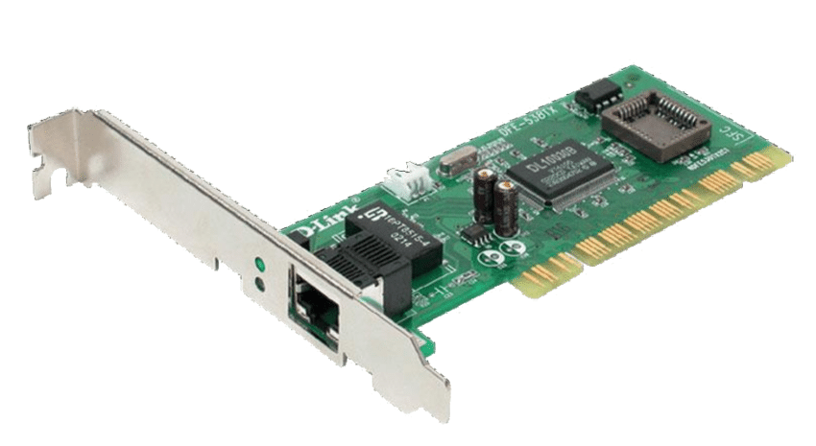





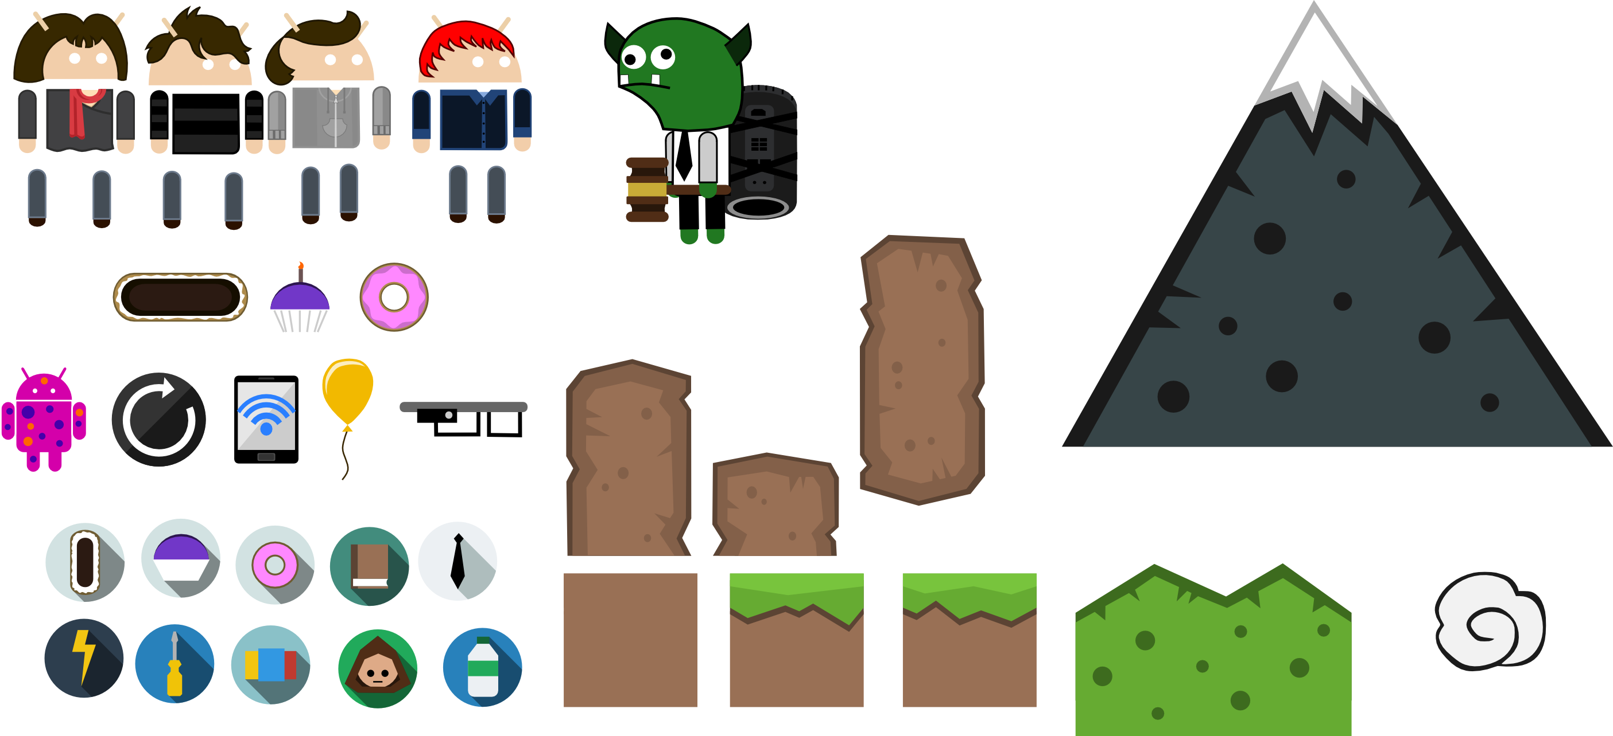


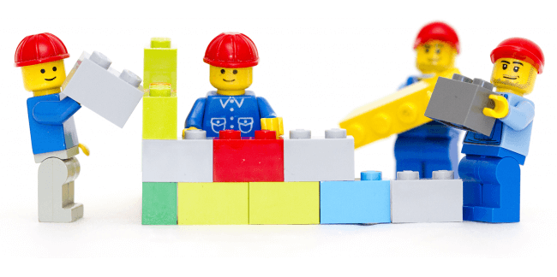









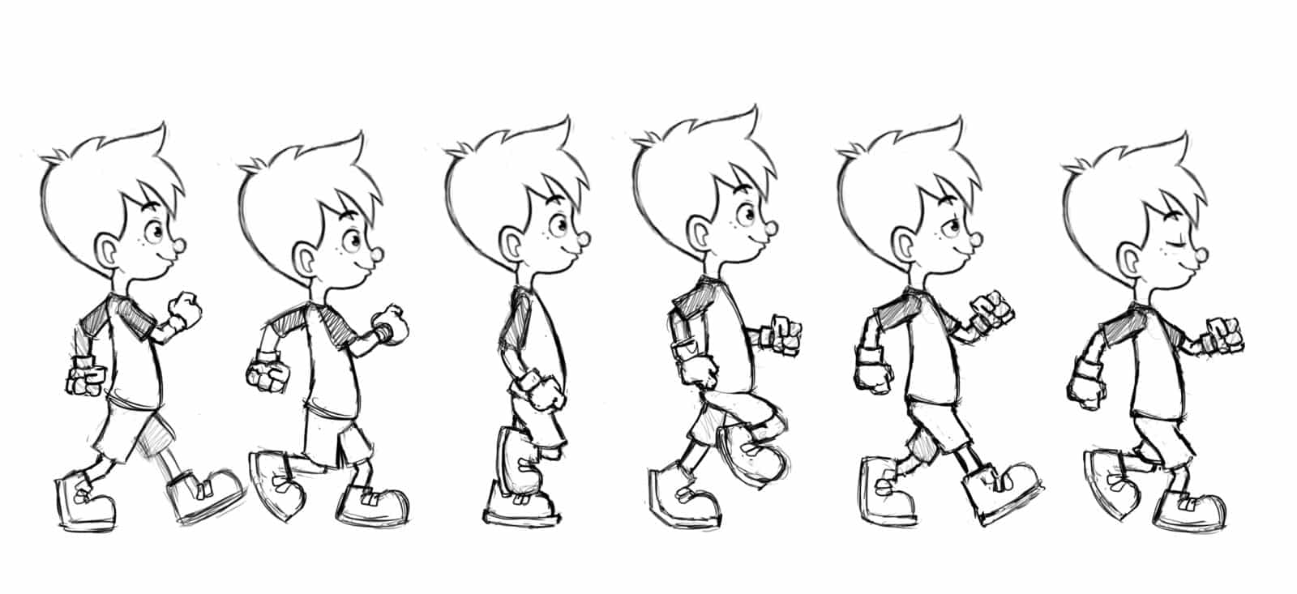


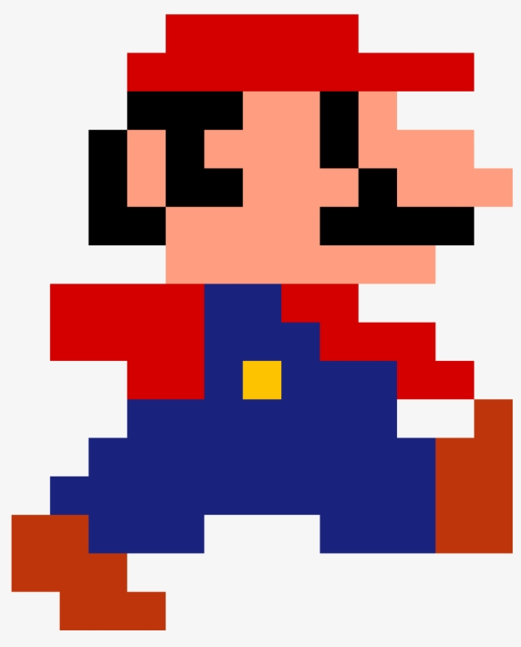


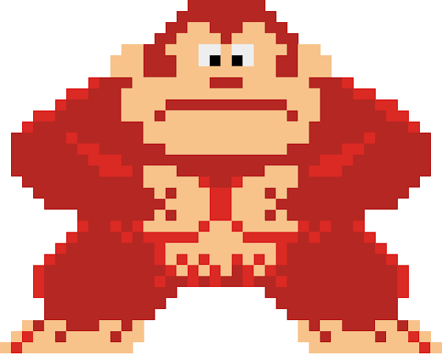








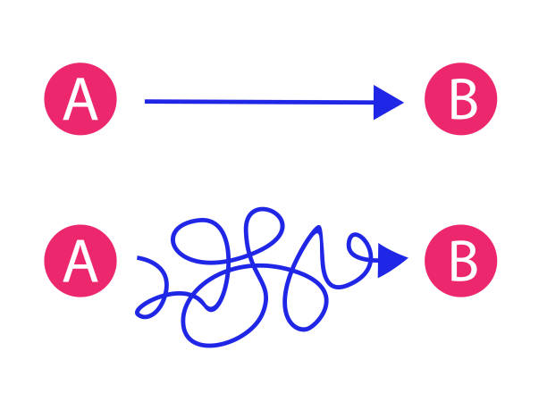





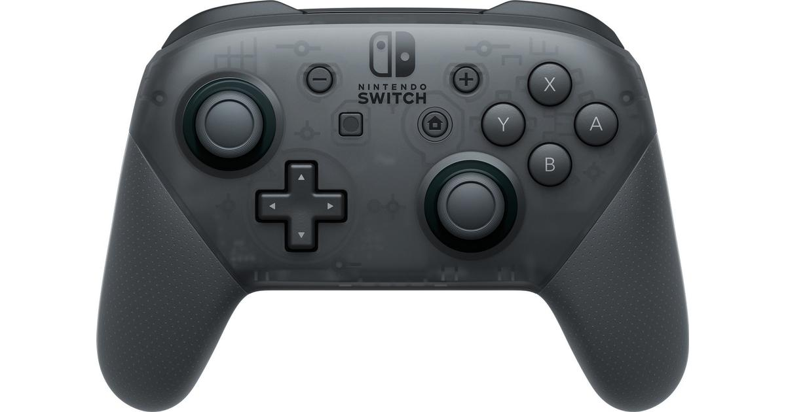

Level 3 BTEC IT
Degrees
Apprenticeships
Careers
Game Developer, Asset Creator, Animation, Games Tester…
Database Administrator,
Social Media Manager, Web Developer…
NEXT STEPS
Create Game
Test Game
Evaluate
Digital Media Skills (CA)
Information Systems (Exam)
Connectivity
Being Online
Impacts of IT
Legal
Uses of Data
Networks
Choosing Systems
Software
Components
Devices
Information Systems (Exam)
Digital Media Skills (CA)
Game Production
Gather / Edit / Make Assets
Analyse the Brief
Testing
Planning
Assets
Editing
Development
Game Production
YEAR
13
Website Development
Design
Performance
Audience
Planning
Creating
Effectiveness
Audience
Interactions
Posts
Planning
Campaign
Social Media
Game Testing
Regression Testing
Fixing Bugs
Bug Reporting
Bug Reporting
Development Methodologies
Reasons for Testing
Backgrounds
Persistence of Vision
Sequencing
Frame Rates
Animation Types
Tweening
Bitmap or Vector
Backgrounds
Sprites
2D Animation
Databases Exam
Social Media
Evaluate
Business Use
Platforms
Sound
Forms
Reporting
Querying
Validation
Structure
Uses
YEAR
12
Databases
Game Engine Scripting
Collisions
Controls
Animation
Game Engines
YEARS
10/11
Physics
GCSE Computer Science
iMedia Gaming
iMedia Film & Photo
Traditional
Gaming
This Photo by Unknown Author is licensed under CC BY-SA

