Slide 1



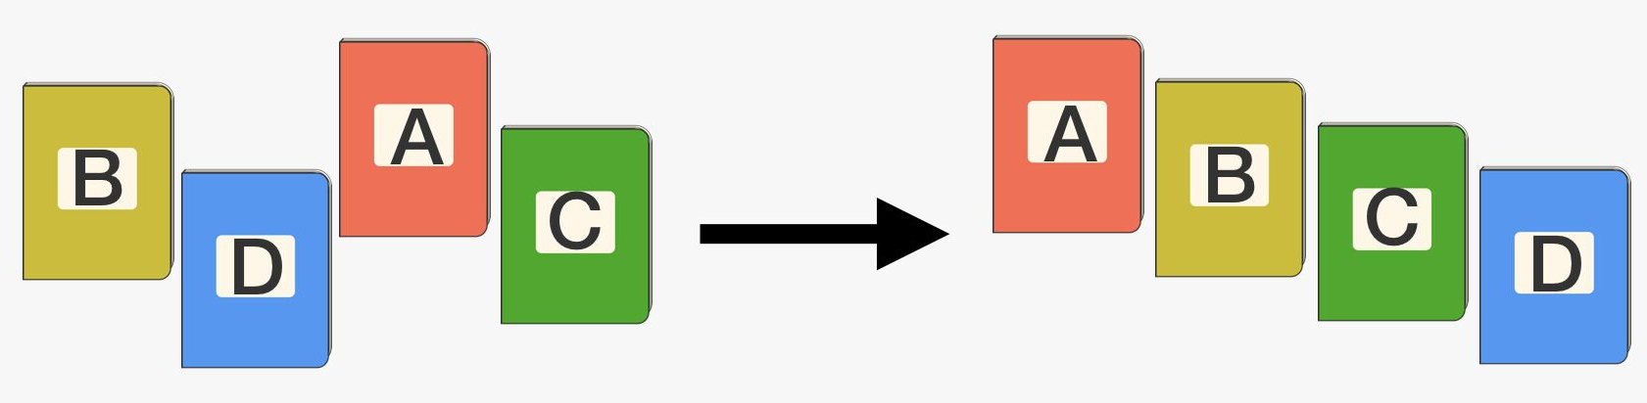



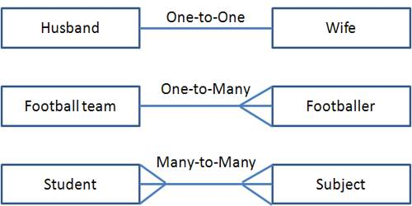
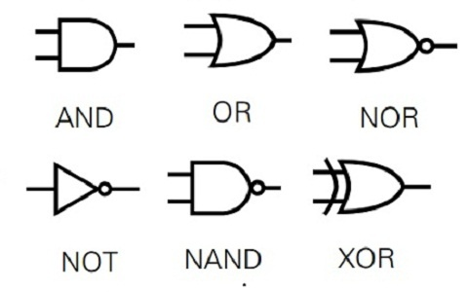
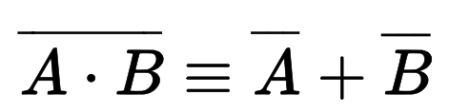

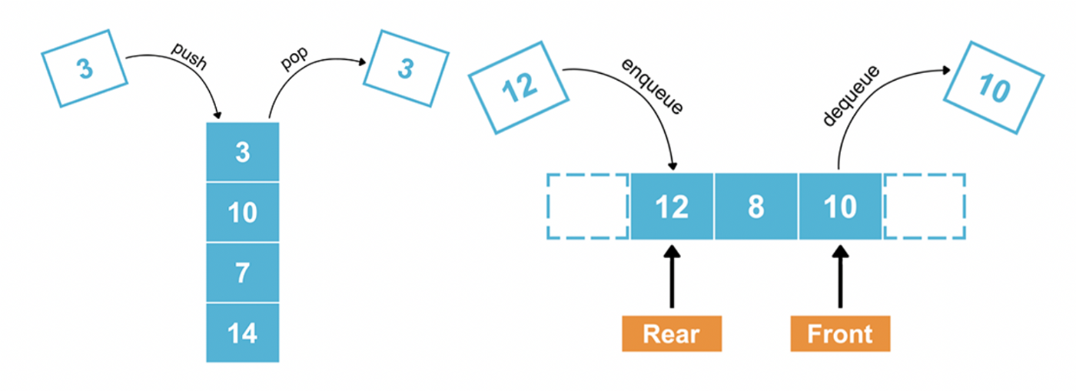



Computer Science
A Level
Degrees
Apprenticeships
Careers
Programmer, Data Analyst, Robotics,
Artificial Intelligence, Hardware Engineer,
Network Management, Gaming, Web,
Cyber Security, Business Analyst,
Cloud Computing, Forensic Investigator
Database Administrator, Research…
NEXT STEPS
Pre-release
Hierarchy Charts
Code Walkthroughs
?
Inheritance Diagrams
Sample Questions
Paper 1 Preparation
Exam
Big Data
NEA
Three Vs
DFS
Review
Final Hand-in
VVV
ACID vs BASE
Big O
Syntax Diagrams
Backus Naur
Reverse
Polish
Turing Machines
Finite State Machines
O
Computational Thinking
NEA
Legal, Ethical & Environmental
Testing
Technical Solution
FOI
RIP
Computer Misuse
Data Protection
Searching
Sorting
Route Finding
f
Doman &
Co-domain
Higher Order Functions
Map, Fold, Filter
Algorithms
Functional Programming
YEAR
13
NEA
Legal, Ethical & Environmental
NEA
Design
Technological Change
Personal Data
Cultural Considerations
Technical Solution
Objectives
Decisions
Pre-release code
Embedded SQL
SQL
Structure
NEA
Exam Preparation
Databases
Networks
Data
Customers
Theory
TCP/IP
Internet
Protocols
Object Orientation
Encapsulation
Inheritance
Uses
ERDs
Keys
OOP
Programming Paradigms
Databases
Logic
Networks
Gates
Expressions
DeMorgan
Transmission Types
Bit Rate
Baud Rate
Latency
Graphs
Stacks & Queues
Decomposition
Operators
Building Blocks
Data Types
YEAR
12
Programming & Data Structures
Hardware & Software
Data Representation
Peripherals
Operating Systems
Fetch-Execute
Nyquist
Coding
Numbers
1001010101010101
YEARS
10/11
GCSE Computer Science
iMedia Gaming
This Photo by Unknown Author is licensed under CC BY-SA

