Slide 1
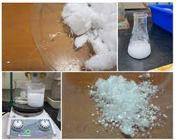
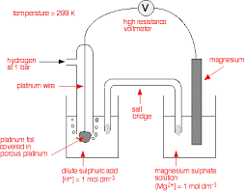
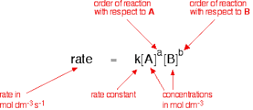
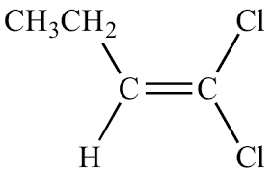
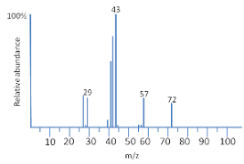
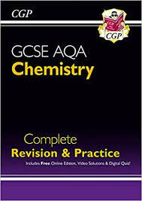
Chemistry A Level
NEXT STEPS
Degrees: Chemistry, Chemical Engineering, Biochemistry, Biomedical Science, Medicine, Dentistry, Pharmacy, Veterinary Science
Apprenticeships: Pharmaceutical/Chemical companies
Careers: Research, Forensic Science, Nurse, Doctor, Vet, Dentist, Environmental scientist, Teacher Water Industry, food scientist, Pharmacist, Chemical engineer
Biochemistry
Acid
Anhydrides
Retention
Factor
Aspirin
Zwitterions
Double
Helix
Reaction pathways
Complexes
Coordination
Number
Acylation
Polymerisation, Amino Acids, Proteins & DNA
Organic Synthesis & Chromatography
Transition Metals & Aqueous Ions
Rates
K_{p}
Electrode Potentials
Mole
Fraction
Arrhenius
Equation
Initial and
Continuous
Rate
Partial
Pressure
Reducing Agent
Oxidising Agent
Standard
Hydrogen
Electrode
EMF=E_{RHS}-E_{LHS}
Standard
Electrode Potentials
Strong and
Weak Acids
Enthalpy
Change
Acidic
Oxides
Kw and
Buffers
Gibbs Free
Energy
Entropy
Change
C NMR
Basic
Oxides
H NMR
Acids
Thermodynamics
NMR
Period 3
Esters
Carboxylic Acids
Amines
Aromatic
Aldehydes & Ketones
YEAR
13
Sweet smelling
Salt formation
Acyl Chlorides
Friedel Craft
Optical Isomerism
Nucleophilic Addition
Nitrogen
Benzene
Polymerisation
Reflux & Distillation
Functional Group tests
Reaction pathways for aliphatic organic compounds
Maxwell Boltzmann
Electrophilic Addition
Oxidation
Elimination
IR
Calculating rate
Alkenes
Alcohols
Analysis
Synthetic pathways
Kinetics
Energetics
Equilibria
REDOX
Halogens
Hess’s Law
Calorimetry
Le Chatelier
Kc
Esters
Half Equations
Redox
Killing bacteria
Moles
Titrations
Gases
Hydroxides
Sulfates
Patterns
Patterns
Filling Shells
Time of Flight Spectroscopy
A
A
YEAR
12
Calculations
Group 2
Periodicity
Ionisation Energy
Atomic Structure
A
A
A
Halogenoalkanes
Alkanes
Introduction to Organic Chemistry
Structure & Bonding
Ozone
Elimination
Nucleophilic Substitution
Free Radical Substitution
Stereoisomers
Naming
Ionic, Covalent, Metallic Bonding
Cracking
Structural Isomers
IMF
YEARS
10/11
Fundamental Ideas, Atomic Structure, Periodic Table, Earth’s Resources, Chemical Changes (Metals, Acids, Electrolysis),
Organic (Crude Oil, Alkenes & Alcohols, Polymers), Atmosphere, Rates, Reversible Reactions, Using Resources, Chemistry Calculations, Structure and Bonding, Energy in Chemistry
This Photo by Unknown Author is licensed under CC BY-SA

