Slide 1

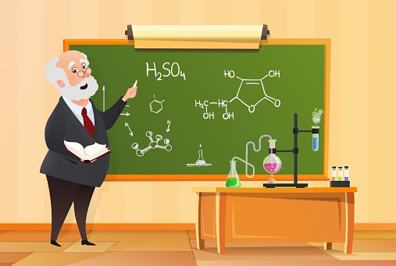

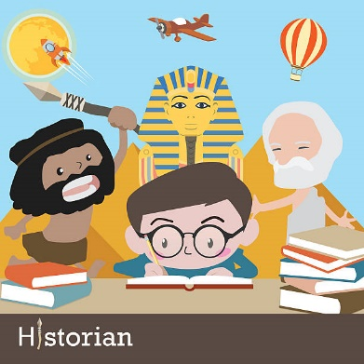
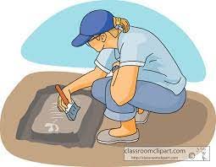



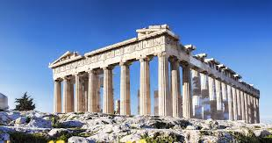
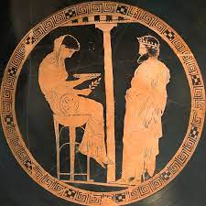
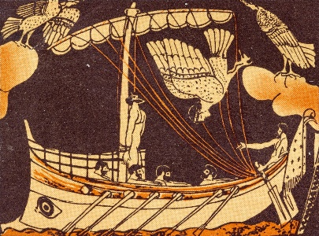
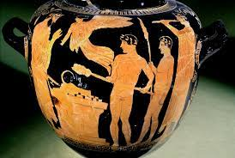
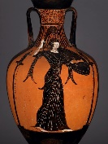
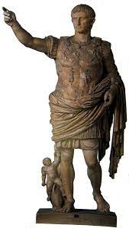
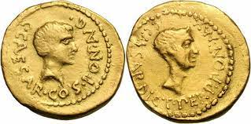
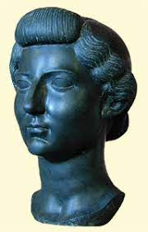
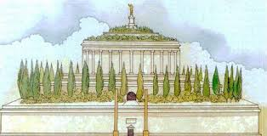
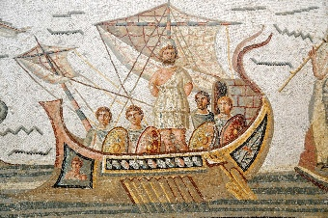
A-LEVEL CLASSICAL CIVILISATION
LEARNING JOURNEY
Year 12
Skills
Year 13
Learning content of course
Essay writing skills
Analysis of key ideas
Skills of analysis
Evaluation of ideas
Drawing conclusions
Independent study
Debating
Application of subject terminology
Journalist
Teacher
Gallery / Heritage Manager
Historian
Archaeologist / Archivist
Curator / Art director
Publishing
Civil Service
Apprenticeship
University
April – May: Year 13 revision programme
Xenophanes’ critique of the Gods of Homer
Religion and Philosophy
Rituals and Priests
Future
Steps
Socrates and impiety
Philosophical thinking in the Greek context
Libations and votive offerings
Blood sacrifices
Priests and priestesses
Why ritual was performed
Olympia & the Olympic Games
Delphi and the Delphic Oracle
World of the Hero revision programme
Different peoples and societies in the Aeneid
Review key characters and themes
Book 12 and the ending to the Aeneid
Women in the Aeneid
The Athenian Acropolis & its civic importance to Athens
Narrative and descriptive techniques, imagery & speech
The Role of the Gods in the Aeneid
What kind of hero is Aeneas?
The Role of the Gods in the Aeneid
Promotion of Augustus in the epic
Book 9: death in the epic
Book 10: youth in the epic
Review and analysis of relationships the Aeneid
Characterisation of Camilla
Places of Worship
Aeneid Book
7 & 8
Book 11. The effects of war
Dido
The Panathenaia
War in the Aeneid
Politics and religion
Aeneid Book 2: Retelling the fall of Troy
The Nature of Olympian Gods
Homer and Hesiod
Gods and mortals
Epithets
Personal Experience of the Divine
Eleusinian mysteries
Oracle at Dodona
Religious participation: household, deme, polis, Panhellenic
Sources of religious authority
Aeneid Book 1: Dido & Aeneas, Piety
Hero cults & Panhellenism
Mystery Cults
Asclepius
Religion and Society
Overview of Greek Religion Topic
Anthropomorphism
& power
The Sebasteion at Aphrodisias
Suetonius
Res Gestae
Augustus’ Legacy & Later representations
Augustus & his sons
Propertius Elegies 3.12/ 3.4/ 4.6, Ovid Metamorphoses
Horace Odes 3.6/4.15/4.4,
Ara Pacis, Forum of Augustus, Kalabsha Gate
Homeric influence
H408/31 Greek Religion
Augustus’ death
Mausoleum
Building programme
A Golden Age
Augustus Father of the State
Composition, structure & plot. Language of the epic
Y13
Augustus adjusts his relationship with Julius Caesar
Augustan context
Historical background to the Aeneid
The World of the Hero:H408/11
Virgil’s Aeneid
Presentation skills for thematic presentation
Thematic Study of the Odyssey: Women, Immortals, Relationships, Justice, Revenge, Fantasy, Reality, Loyalty, Betrayal
Ancient Greek context within characters and themes
Character Exploration:
Odysseus
Penelope
Telemachus
Athene
Suitors
Circe
Calypso
Phaeacians
Augustus secures peace throughout the Empire
Reading Homer’s Odyssey
Exam style questions – 30 mark response
Reading Homer’s Odyssey
Mock exam
Reading Homer’s Odyssey
Characterisation within the Epic
Debating and presentation skills
Augustus the Religious leader
Augustus saves the Republic
Themes, form, structure
Augustus’ Reign
29 BC – AD 14
The Second Triumverate
Divi Filius
Power Struggle 42-30 BC
Imperator Octavian
Octavian and Apollo, Octavian and Livia
Antony’s mistakes
Cleopatra and the Battle of Actium
Horace Epode 9,
Odes 1.37
Propertius Elegies 3.11
Aureus 43 BC
The triumvirate falls apart
Octavian becomes Caesar
Octavian Comes to Rome 44-42 BC
Themes:Divi Filius, Imperator, Augustus, Culture Hero, Pater Patriae
Introducing Ancient Sources
Roman culture and traditions
Historical and Geographical Context
Introduction to specification, assessment and skills
H408/22 Culture and the Arts: Imperial Image
Reading Homer’s Odyssey
Life of Julius Caesar
Republican Rome
Exam style questions – 20 mark response
Y12
Ancient Greek Culture concepts including Xenia, Kleos, Time
Analytical writing – Exam question response planning 10 mark questions
Ancient Greek Historical and Mythological Context
The Olympians: Who are they? What role do they play in the Epic?
The Timeline of Homeric times and Mycenaean era
Homer – who was he?
The Homeric Question
What makes a hero?
What is Classical Civilisation: Ancient Greece
H408/11 The World of the Hero: Homer’s Odyssey
The World of the Hero
40%
Culture and the Arts
30%
Beliefs and Ideas
30%
LINKS TO GCSE:
GCSE English Literature
GCSE History
GCSE Religious Studies

