Slide 1
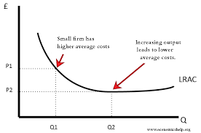
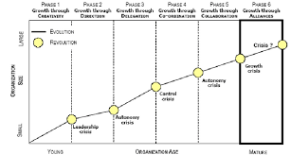
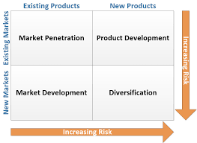
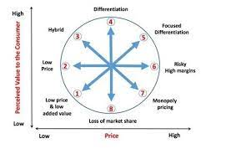
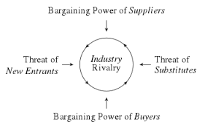
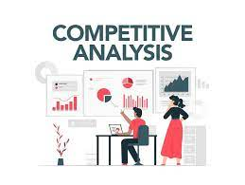




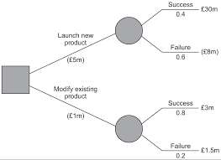


Business A Level
A Business A level will benefit all students, whether you plan to study at University, apply for an apprenticeship or enter the world of work. It is applicable to almost all choices of career.
NEXT STEPS
Change in scale
Greater use of technology
Causes of change
Barriers to change
Managing strategic implementation
Innovation
Strategic methods
Managing Change
Internationalisation
Greiner’s model
Problems with strategies and why they fail
MNCs
A
Managing organizational culture
Factors that influence…
Porters strategic choices
Porter’s 5 forces
Ansoff Matrix
Choosing strategic Direction
Analysing strategic options
Bowman’s strategic clock
Investment appraisal
Influences on missions
Strategic and functional objectives
Financial ratio analysis
Core competences
PESTLE analysis
Missions
Internal Analysis
External Analysis
YEAR
13
Short and long term performance
Corporate Social Responsibility
Distinction between strategy and tactics
SWOT analysis
Balanced scorecard
Globalisation
Motivation
Analysing HR Performance
HR Objectives
Cash flow
Analysing financial performance
Setting financial objectives
HR
Finance
Employer / employee relations
HR flow
Organisational design
Improving Profitability
Breakeven analysis
Sources of finance
Marketing objectives
Market data analysis
Marketing Mix
Operations Objectives
Analysing operational performance
Quality
Marketing
Operations
Market Research
Market segmentation and Targeting
Elasticity
Efficiency and productivity
Inventory
Supply chain management
Stakeholder Mapping
Stakeholders
What managers do
Concept of Shareholding
Missions and Objectives
Nature of business
YEAR
12
Leadership & Mgt
What is a Business?
Decision trees
Scientific and non scientific decision making
Leadership styles
How external factors effect businesses
Different forms of businesses
Concept of Profit
YEARS
10/11
No need to study Business at GCSE
This Photo by Unknown Author is licensed under CC BY-SA

