Slide 1
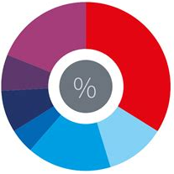













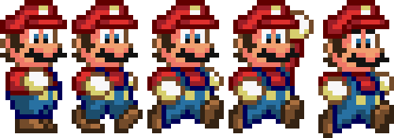
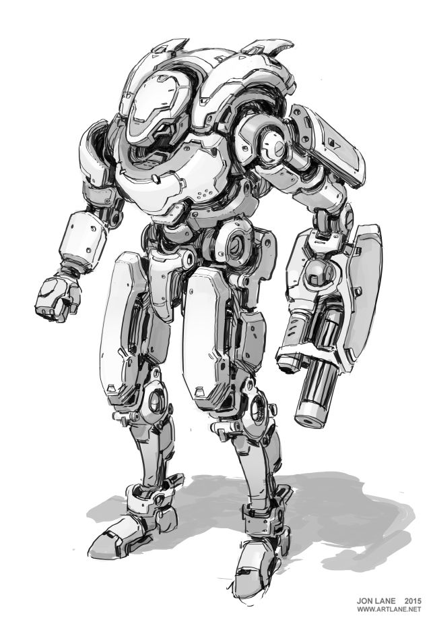

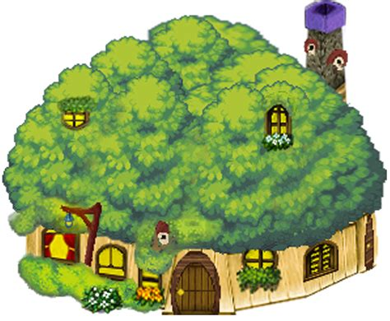
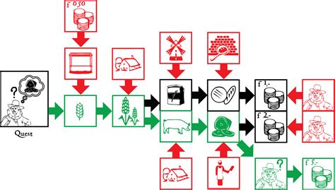

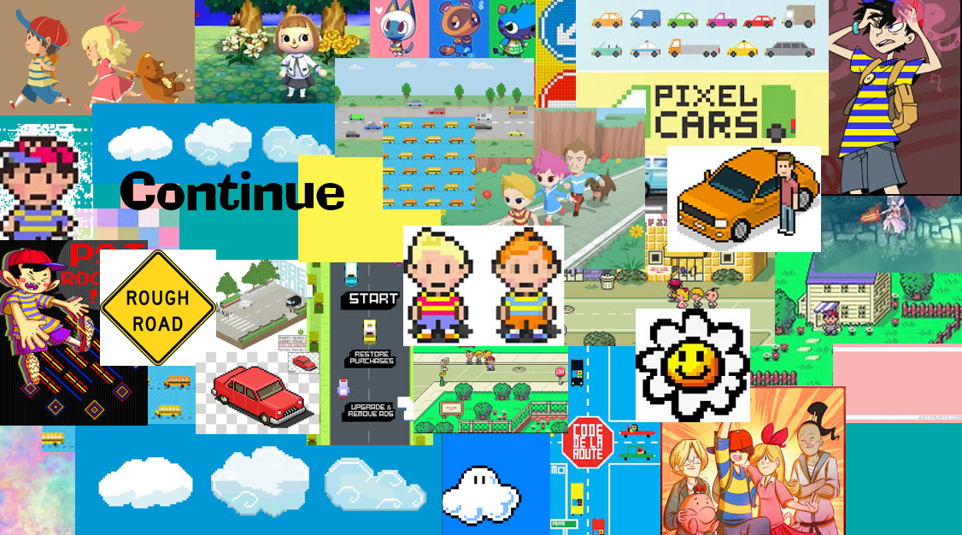



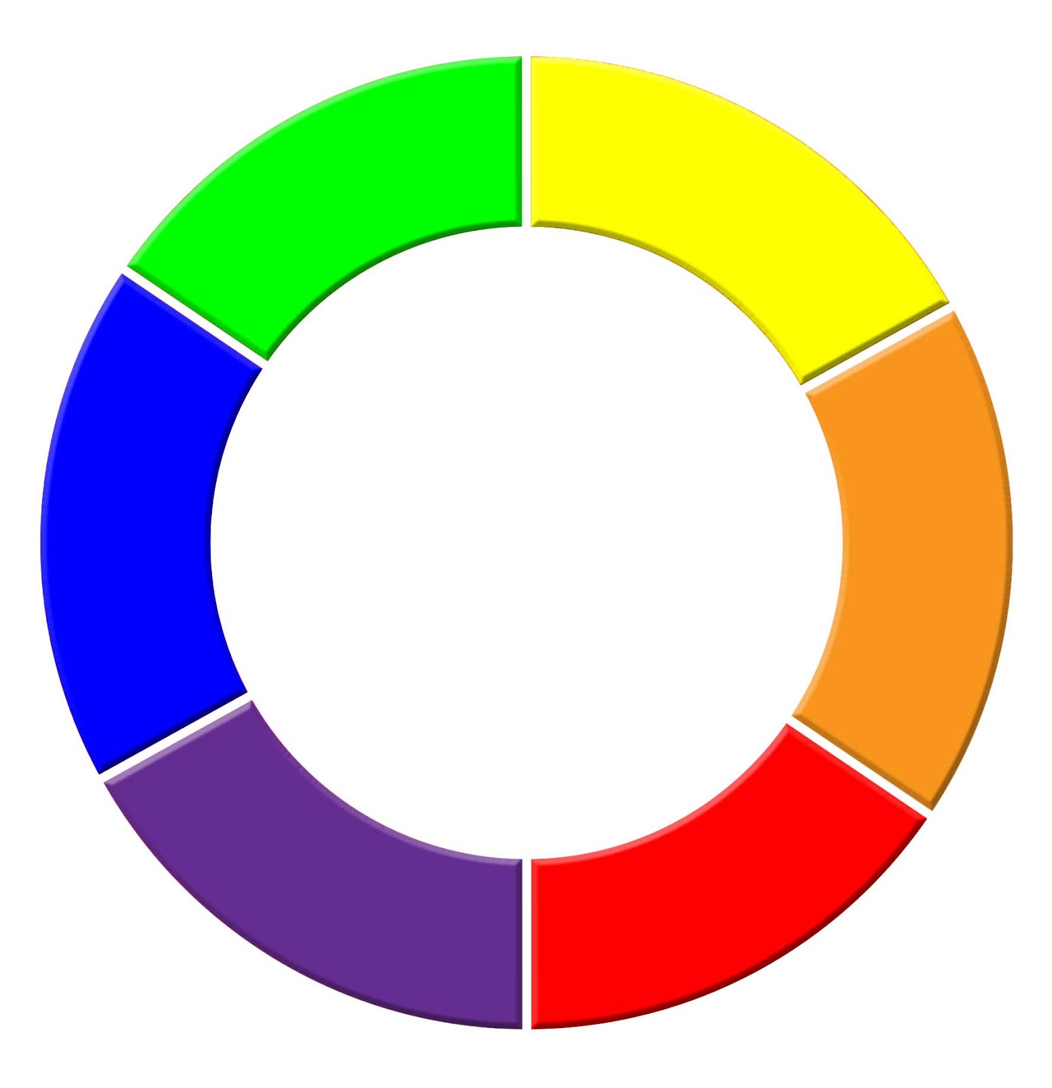












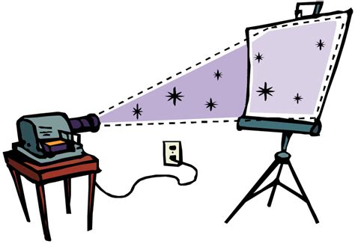



iMedia Gaming
Computer Science
Gaming
IT
A Levels
T Levels
Apprenticeships
Careers
Game Designer
Game Developer
Digital Art
NEXT STEPS
The Media Industry
Sectors
Roles
Product Design
Audience
Codes
Creative iMedia in the Media Industry
Legal
Distribution
Platforms
Formats
Pre-production Planning
Ideas
Backgrounds
Props
999
Scoring
Digital Games
YEAR
11
Flowcharts
Characters
Concept Sketches
Artwork
Moodboards
Digital Games
Visual Identity…
Narrative
Visualisation Diagrams
Fonts
Logos
House Style
Abcde
…and Digital Graphics
YEAR
10
Mindmaps
Graphics
Colours
Tables
& Columns
Breaks
Basics: Colours, Borders, Naming
Functions
Using Word
Using Excel
Basics: Fonts, Images, Justification
Header
& Footer
Audience
Formulae
Graphs
Media
Animations
Illegal
Content
Staying Safe Online
Online Reputation
YEAR
9
Using PowerPoint
E-Safety
Ordering
Layouts
The
Bubble
Fake
News
Data &
Your Rights
YEAR
7&8
Create store and organise, Using technology beyond school, Considering privacy, Searching, Logical reasoning, Create and use digital information, Represent different information, Hardware and software components, Digital identity, Introduction to algorithms.
This Photo by Unknown Author is licensed under CC BY-SA

