Slide 1



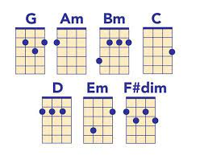






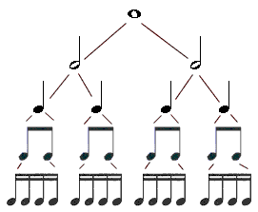
Drama
A Levels T Levels Apprenticeships
Careers : Arts Management, Broadcasting/Media, Law, Management Consultancy, Teaching or Television: the transferable skills are endless.
NEXT STEPS
Component 1 theory lessons on-going
“To explore drama as a practical art form in which ideas and meaning are communicated to an audience through choices of form, style and convention” - AQA specification
Spring Term 2
Practical exam -
March
Summer Term 1
Summer Term 2
Component 3 Exam
Marked by AQA
Component 1 Written exam skills revision
‘Romeo and Juliet’
/Live Theatre revision and timed responses
Roles in the theatre, stage positioning and stage configuration revision
Component 1 exam
(May)
Spring Term 1
Autumn Term 2
Practical exam - November
Autumn Term 1
Component 2 0n-going NEA, applying theatrical skills analysing/
evaluating own work
Component 2 NEA
Devising Logs alongside practical work
Component 2 NEA
Practical Devising
Creating and developing ideas to communicate meaning for theatrical performance
YEAR
11
School production
(February)
Component 3
Texts in Practice
Applying theatrical skills to realise artistic intentions in live performance
Component 1
theory lessons
on-going
Live Theatre, responses and evaluation
Component 1 theory lessons on-going
Component 1 theory lessons on-going
Spring Term 1
Summer Term 1
Spring Term 2
Summer Term 2
‘Romeo and Juliet’
Developing knowledge and understanding of the characteristics and context of whole play
To analyse and evaluate the work of live theatre makers
Texts in Practice – introduction of script work
Texts in Practice
Live theatre continued and focus on written exam skills
‘Romeo and Juliet’ – study and explore practically
End of Year written exam
‘Romeo and Juliet’/Live Theatre
YEAR
10
Autumn Term 2
Autumn Tem 1
Roles in the theatre, stage positioning and stage configuration
Develop skills in group performance
Vocal and physical elements of drama explored via individual, pair, group and teacher-led activities
Develop knowledge and understanding of characteristics of performance through monologue/duologue/group
Introduction to drama. Performance skills explored
Component 2 project – Homelessness. Devised piece and Devising Logs in preparation for Year 11
Pupils can choose Drama as an option from Year 10. Key skills required are; creativity, commitment, self - evaluation, analysis, problem-solving as part of a team and a willingness to be brave and try new things. It is recommended that pupils take a keen interest in the world of theatre. Are you already part of a theatre group? Do you want to build upon your knowledge and understanding of how drama is developed and performed? Are you interested in seeing live theatre and analysing/evaluating the work of theatre makers from both a performance and design perspective?
This Photo by Unknown Author is licensed under CC BY-SA

