Slide 1


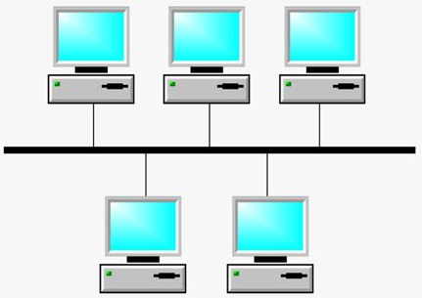














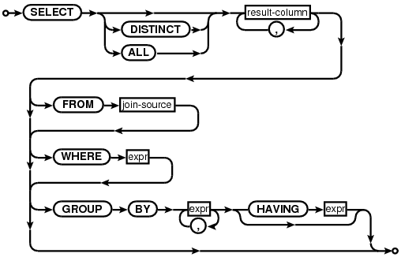


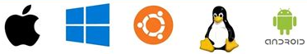






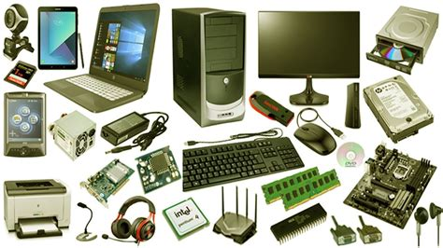
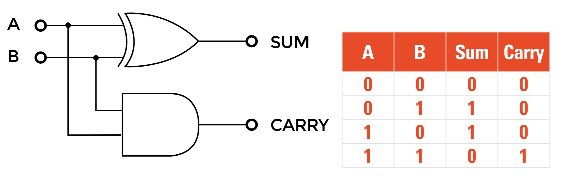



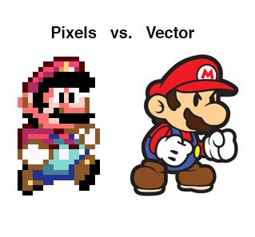
















Computer Science
A Levels
T Levels
Apprenticeships
Careers
Computer Science
Gaming
IT
Programmer, Cyber Security, Analyst, Databases, Business, Research, Networking
NEXT STEPS
Threats
Risks
Topologies
Equipment
Searching
Sorting
Security
Networks
Programming
Encryption
Protocols
TCP/IP
Comparisons
Challenges
Laws
Ethics
Structure
Uses
Analyse
Plan
Legal
Databases
Controlled Assessment
YEAR
11
Morals
SQL
Execute
Test
Operating Systems
Sequence
Selection
Python
Data Structures
Software
Programming
Utilities
Applications
Iteration
Variables
Files
Challenges
Output
Gates
Input
Sound
Numbers
Hardware
Logic
Data Representation
YEAR
10
Aa
Storage
Processing
Truth Tables
Compression
Images
Text
Tables
& Columns
Breaks
Basics: Colours, Borders, Naming
Functions
Using Word
Using Excel
Basics: Fonts, Images, Justification
Header
& Footer
Audience
Formulae
Graphs
Media
Animations
Illegal
Content
Staying Safe Online
Online Reputation
YEAR
9
Using PowerPoint
E-Safety
Ordering
Layouts
The
Bubble
Fake
News
Data &
Your Rights
YEAR
7&8
Create store and organise, Using technology beyond school, Considering privacy, Searching, Logical reasoning, Create and use digital information, Represent different information, Hardware and software components, Digital identity, Introduction to algorithms.
This Photo by Unknown Author is licensed under CC BY-SA

