Slide 1
GCSE English Literature Exam Board Change 2021
Who does this affect?
This will only affect students in Y or Z sets (11FY, 11FZ; 11GY, 11GZ; 11HY, 11HZ – check your timetable if you are unsure which class you are in).
Please note ALL students will take AQA English Language.
What is changing?
We are moving exam boards from AQA to Pearson (Edexcel).
Why are we doing this?
With Pearson Edexcel, we have more time to teach and learn the content needed for GCSEs.
The texts you’ve studied are exactly the same (Shakespeare, An Inspector Calls or Animal Farm, A Christmas Carol), but the question format is slightly different (I will explain more on this later).
The plan is to use this time to deepen and secure the skills you need to succeed.
Do I still get a GCSE?
YES! Pearson Edexcel is a valid, and recognised GCSE. There will be no difference on your GCSE Results Certificate.

Slide 2
How does the Pearson Edexcel Literature GCSE compare to AQA?
Due to the Lockdown, the government has allowed exam boards to remove a text from their Literature GCSE. As a result of this, both AQA and Pearson Edexcel’s exam papers are changing from the usual format.
Below is a table of what AQA’s and Pearson Edexcel’s papers will look like in Summer 2021.
AQA | Pearson Edexcel
Paper 1 (issued as two separate papers on the day; 50 minutes each) 1B – A Christmas Carol 1C – An Inspector Calls/Animal Farm/Lord of the Flies Note: some schools will choose Anthology Poetry, but we haven’t. | Paper 1 (compulsory: issued as one whole paper; 1 hour 45): Section A: Shakespeare (40 marks) Section B: An Inspector Calls/Animal Farm (40 marks - 32 marks + 8 for SPAG)
Paper 2 (compulsory; 1 hour 45): Section A: Shakespeare Section B: Part 1: Unseen Poetry Response Part 2: Unseen Poetry Comparison Website link: https://www.aqa.org.uk/subjects/english/gcse/english-literature-8702/changes-for-2021 | Paper 2 (one paper, one text;1 hour 20) A Christmas Carol (40 marks) Website Link: https://qualifications.pearson.com/en/qualifications/edexcel-gcses/english-literature-2015/summer-2021-exam-support.html Please note: there is no poetry unit for Edexcel.

Slide 3
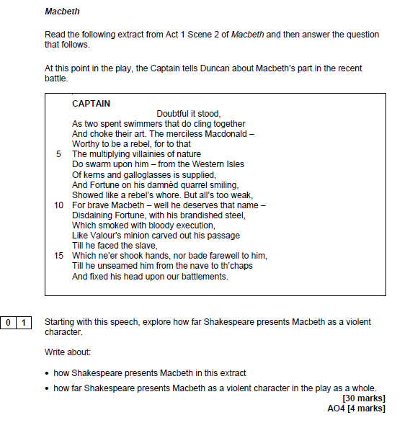
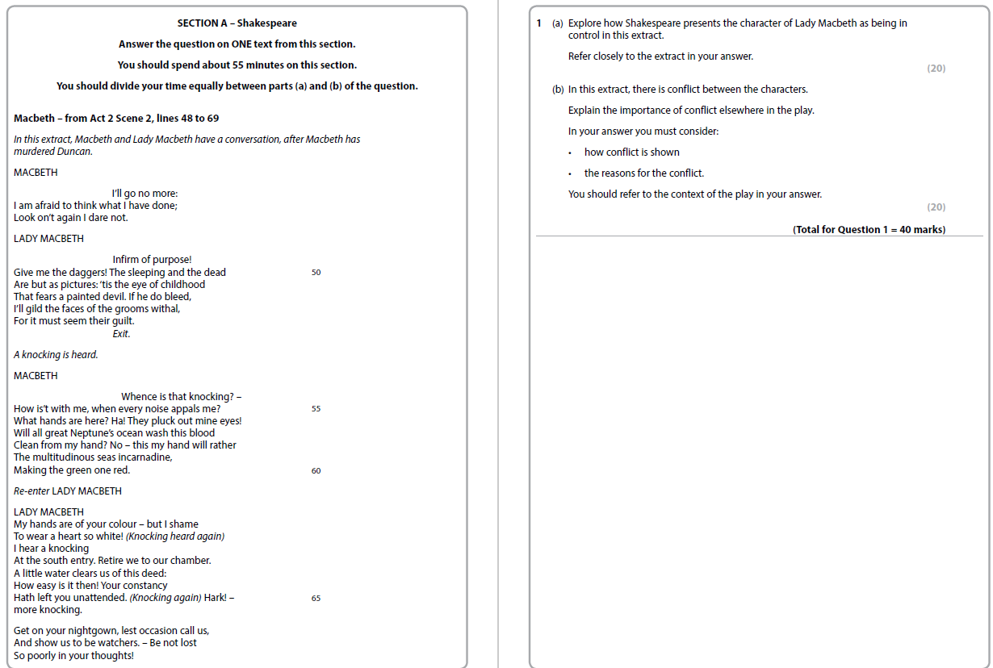
What do the questions look like and how are they different?
Example AQA Shakespeare Question
Example Edexcel Shakespeare Question
Longer extract with more to engage with.
Question is broken down into two parts (extract and whole text) to help scaffold students’ responses.
Part A – AO2: close analysis of language
Part B - AO1 & AO3: ideas, context, intentions and effects
This is what you saw in the December Mocks
Shorter extract
ONE question where students have to explore the extract and the whole text in their response. If they don’t, they can only achieve 10 marks.

Slide 4
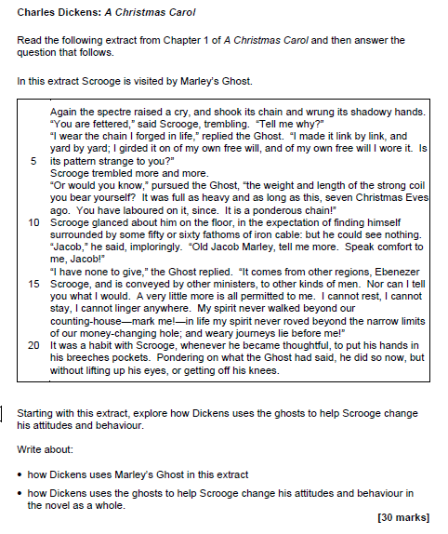
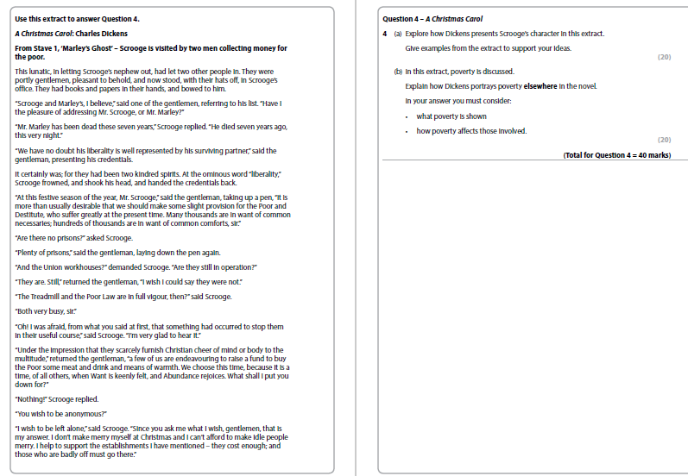
What do the questions look like and how are they different?
Example AQA
A Christmas Carol Question
Example Edexcel
A Christmas Carol Question
Longer extract with more to engage with.
Question is broken down into two parts (extract and whole text) to help scaffold students’ responses.
Part A – AO2: close analysis of language
Part B - AO1 only: ideas, intentions and effects
This is what you saw in the December Mocks
Shorter extract
ONE question where students have to explore the extract and the whole text in their response. If they don’t, they can only achieve 10 marks.

Slide 5
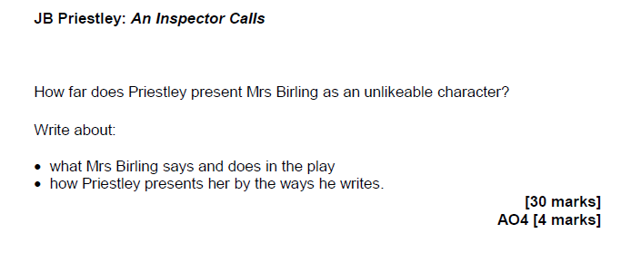
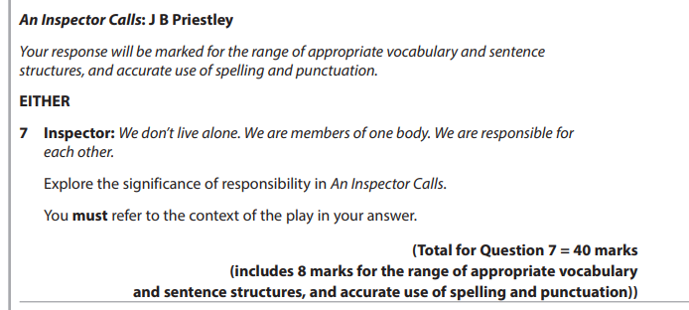
What about An Inspector Calls questions?
Example AQA
An Inspector Calls Question
Example Edexcel
An Inspector Calls Question
AO1 & AO3: ideas, contexts, effects, intentions
Both are very similar in the type of questions they ask.
Note: For Edexcel in the summer exams, Shakespeare & An Inspector Calls will be on the same paper (Paper 1)

Slide 6
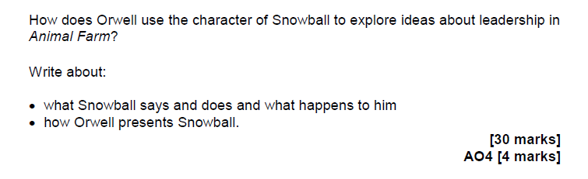
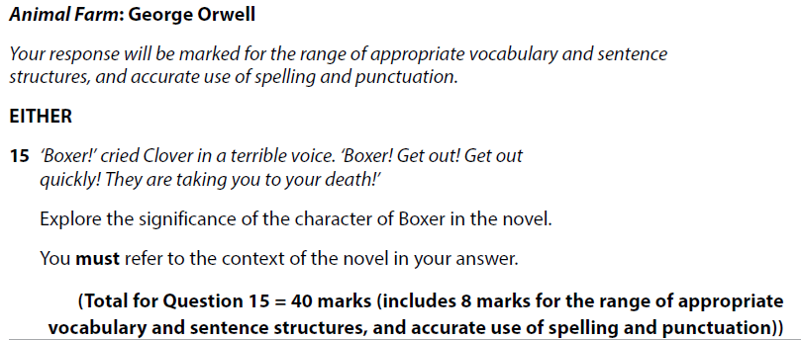
What about Animal Farm questions?
Example AQA
Animal Farm Question
Example Edexcel
Animal Farm Question
AO1 & AO3: ideas, contexts, effects, intentions
Both are very similar in the type of questions they ask.
Note: For Edexcel in the summer exams, Shakespeare & Animal Farm will be on the same paper (Paper 1)

Slide 7
The next few months
December – January
Revising An Inspector Calls/Animal Farm: themes, characters, plot, writer’s intentions, context.
Christmas Holidays: Revision on Modern Text
January – February Half Term: AQA English Language Paper 1
February Mocks: Edexcel Literature Paper 1 (Shakespeare & An Inspector Calls or Animal Farm) and Paper 2 (A Christmas Carol).
February – March: AQA English Language Paper 1 and Paper 2
March Mocks: English Language Paper 1 and Paper 2
April - May: Spoken Language Task and revision.

