Slide 1

Covid-19 Coronavirus
Update for Worcestershire Headteachers
A new virus which started in China in December 2019
Incubation period 2 – 14 days

Slide 2

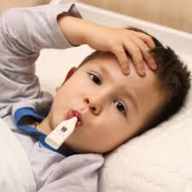

Symptoms
Cough
High temperature
Shortness of breath
Notes:
Generally, these infections can cause more severe symptoms in people with weakened immune systems, older people, and those with long-term conditions like diabetes, cancer and chronic lung disease. There is no evidence that children are more affected than other age groups

Slide 3

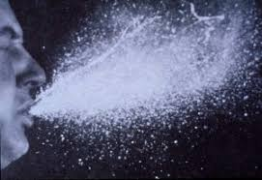
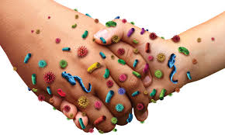
How is its spread
Most likely to happen when there is close contact (within 2 metres) with an infected person.
secretions can be directly transferred into the mouths or noses of people who are nearby (within 2 metres) or could be inhaled into the lungs
it is also possible that someone may become infected by touching a surface or object that has been contaminated with respiratory secretions and then touching their own mouth, nose, or eyes (such as touching a door knob or shaking hands then touching own face).

Slide 4

Preventing spread of infection
Wash hands often with soap and water, or use alcohol sanitiser if handwashing facilities are not available.
Covering coughs or sneeze with a tissue, then throwing the tissue in a bin. Or cough into your elbow/sleeve if you don’t have a tissue.

Slide 5

Wash Hands
before leaving home
on arrival at school
after using the toilet
after breaks and sporting activities
before food preparation
before eating any food, including snacks
before leaving school
https://www.youtube.com/watch?v=aGJNspLRdrc

Slide 6





Keeping Education Settings Clean.

Slide 7
Further Support and Guidance
Specific Educational Guidance
https://www.gov.uk/government/publications/guidance-to-educational-settings-about-covid-19/guidance-to-educational-settings-about-covid-19
OR
Phone Public Health England 0344 225 3560 or NHS 111 has a dedicated advice line

Slide 8
Useful links and resources
E-bug resources
Provides information developed by PHE
https://campaignresources.phe.gov.uk/schools.
KS1: Horrid Hands and Super Sneezes:
Educational teaching resource
https://e-bug.eu/junior_pack_ks1.aspx?cc=eng&ss=2&t=Horrid%20Hands
https://e-bug.eu/junior_pack_ks1.aspx?cc=eng&ss=2&t=Super%20Sneezes

Slide 9
KS2: Hand Hygiene and Respiratory Hygiene
https://e-bug.eu/junior_pack.aspx?cc=eng&ss=2&t=Hand%20Hygiene
https://e-bug.eu/junior_pack.aspx?cc=eng&ss=2&t=Respiratory%20Hygiene
KS3: Hand Hygiene and Respiratory Hygiene
https://e-bug.eu/senior_pack.aspx?cc=eng&ss=3&t=Senior%20Schools-Hand%20Hygiene
https://e-bug.eu/senior_pack.aspx?cc=eng&ss=3&t=Senior%20Schools-Respiratory%20Hygiene
Catch it, Bin it, Kill it.
https://campaignresources.phe.gov.uk/resources/campaigns/101/resources/5016

Slide 10
PHE Coronavirus guidance for education settings:
https://www.gov.uk/government/publications/guidance-to-educational-settings-about-covid-19/guidance-to-educational-settings-about-covid-19
Advice on the Coronavirus for places of education:
https://assets.publishing.service.gov.uk/government/uploads/system/uploads/attachment_data/file/869250/Coronavirus_advice_for_educational_settings_poster.pdf

